Slide 1
Association with Behavioral Data for the 3 Largest Cluster

Slide 2
Settings
Images sind Grand Averages der EKP-Daten
Matrizen sind Plots der Effektgröße, alles, was nicht signifikant wurde ist weiß.
Alles nicht signifikante habe ich künstlich auf 0 gesetzt
Bei den nur behavioralen Tests (Error Cond 1 vs Error Cond 2) hat die x-Achse keine Bedeutung, habe ich nur aus Konsistenzgründen so geplottet.

Slide 3
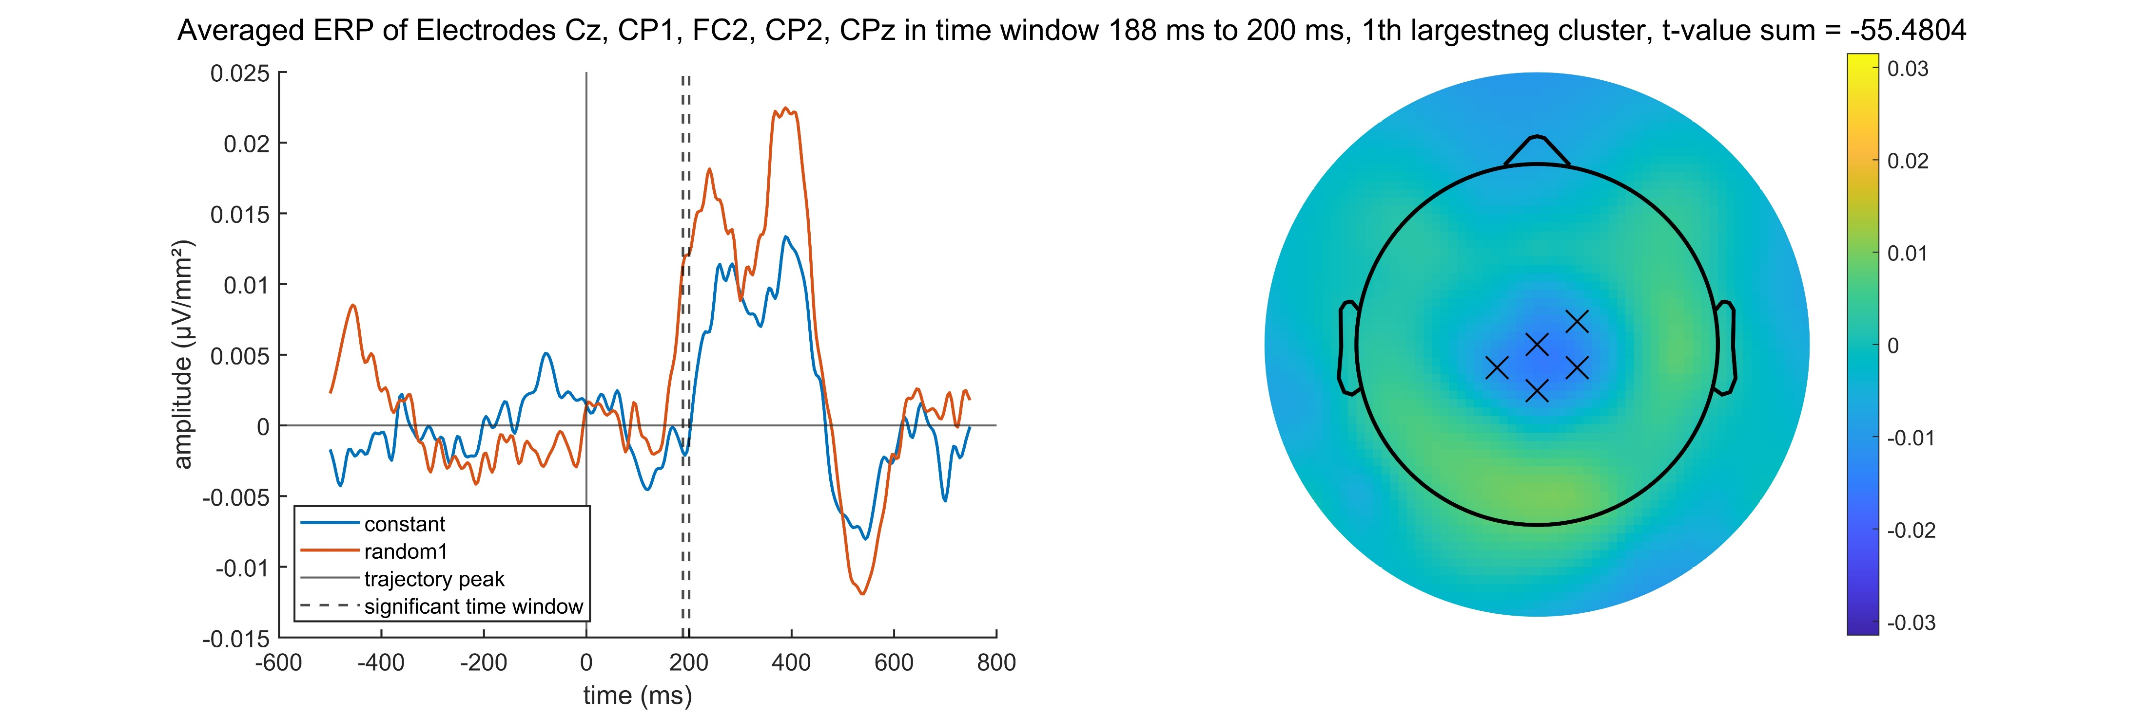
Constant – Random1 negative

Slide 4
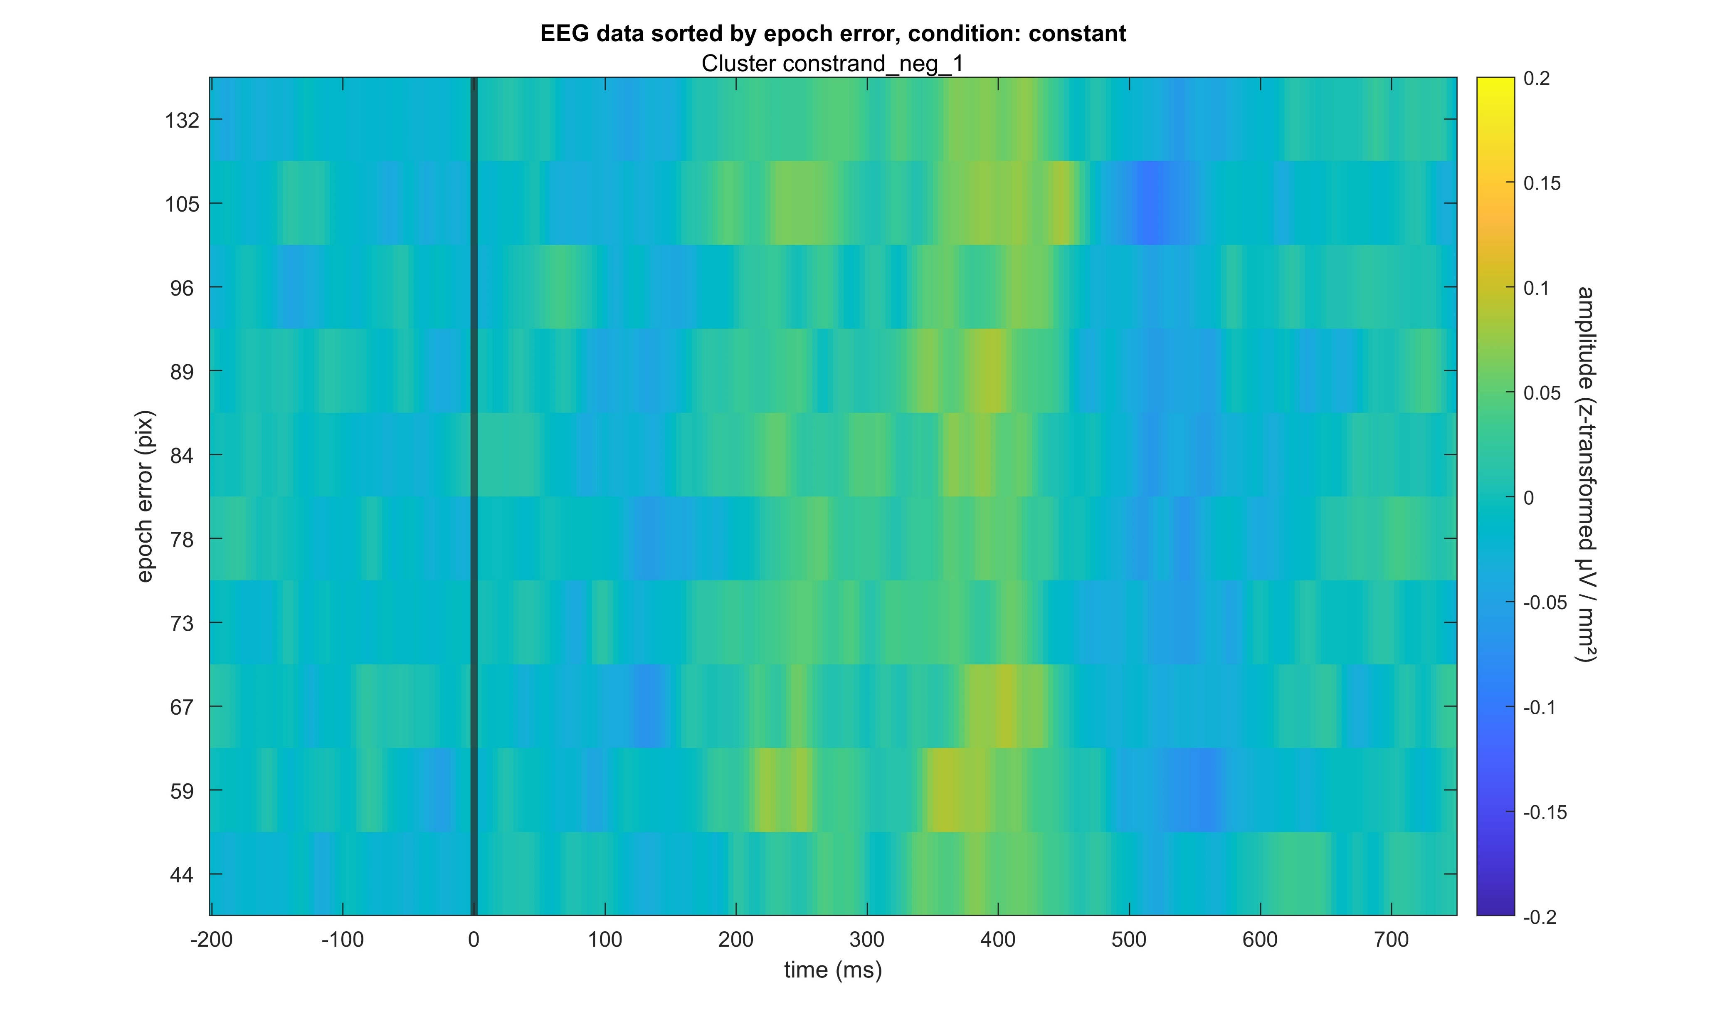
Constant – Random1 negative

Slide 5
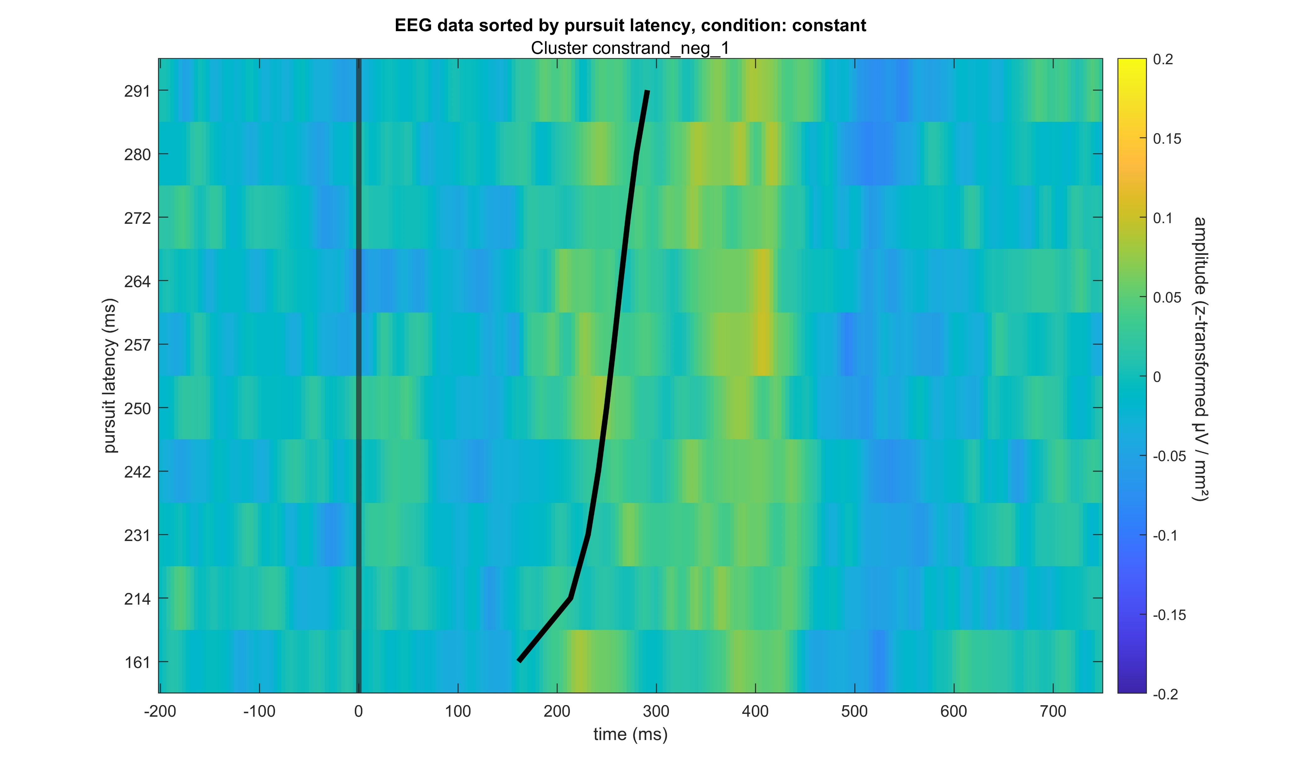
Constant – Random1 negative

Slide 6
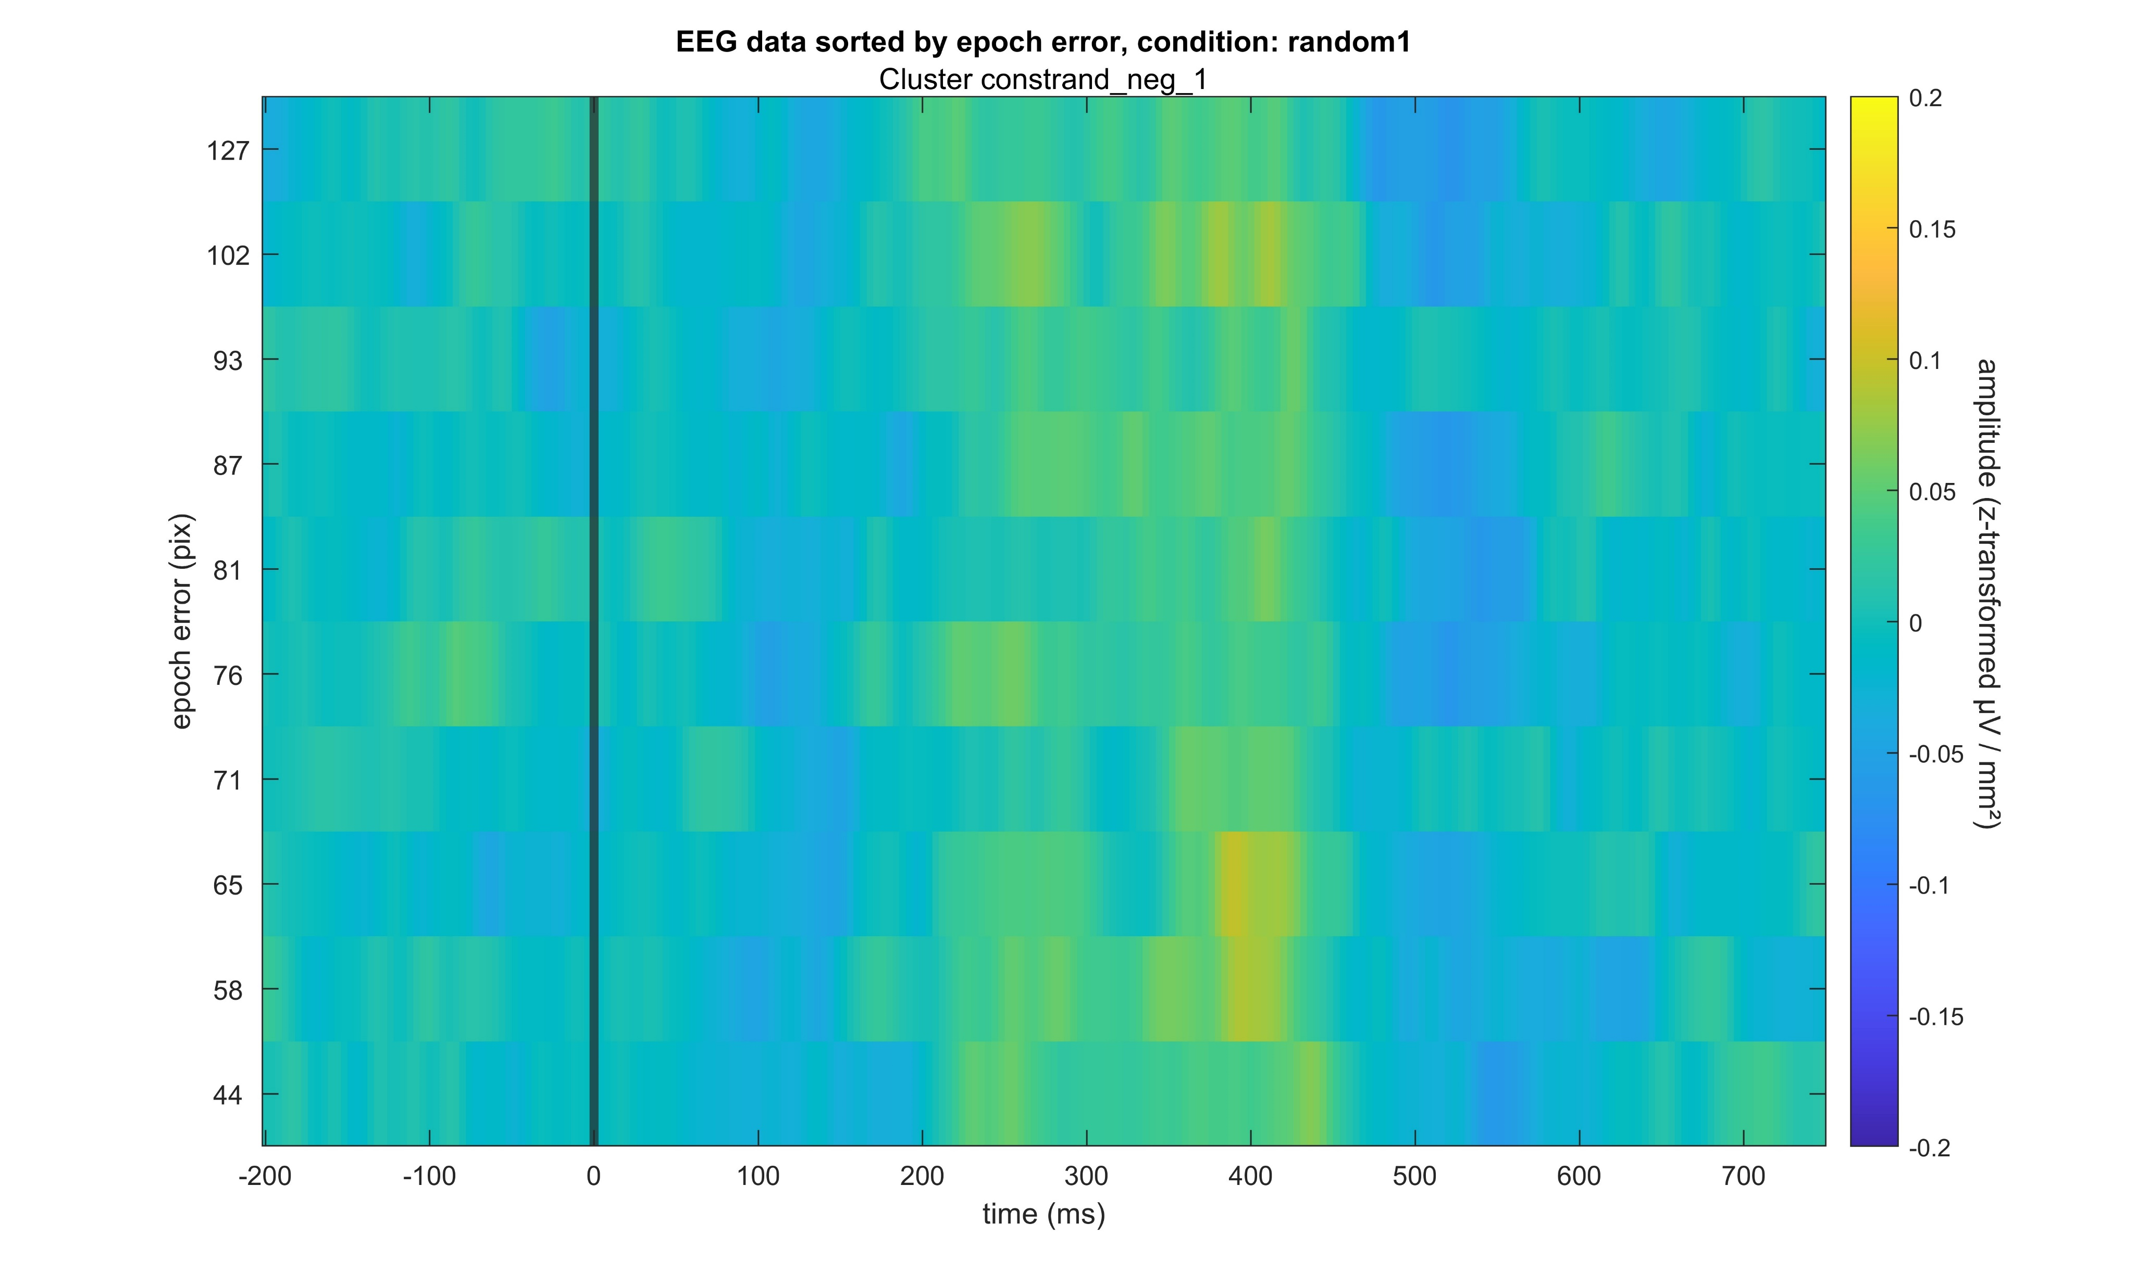
Constant – Random1 negative

Slide 7
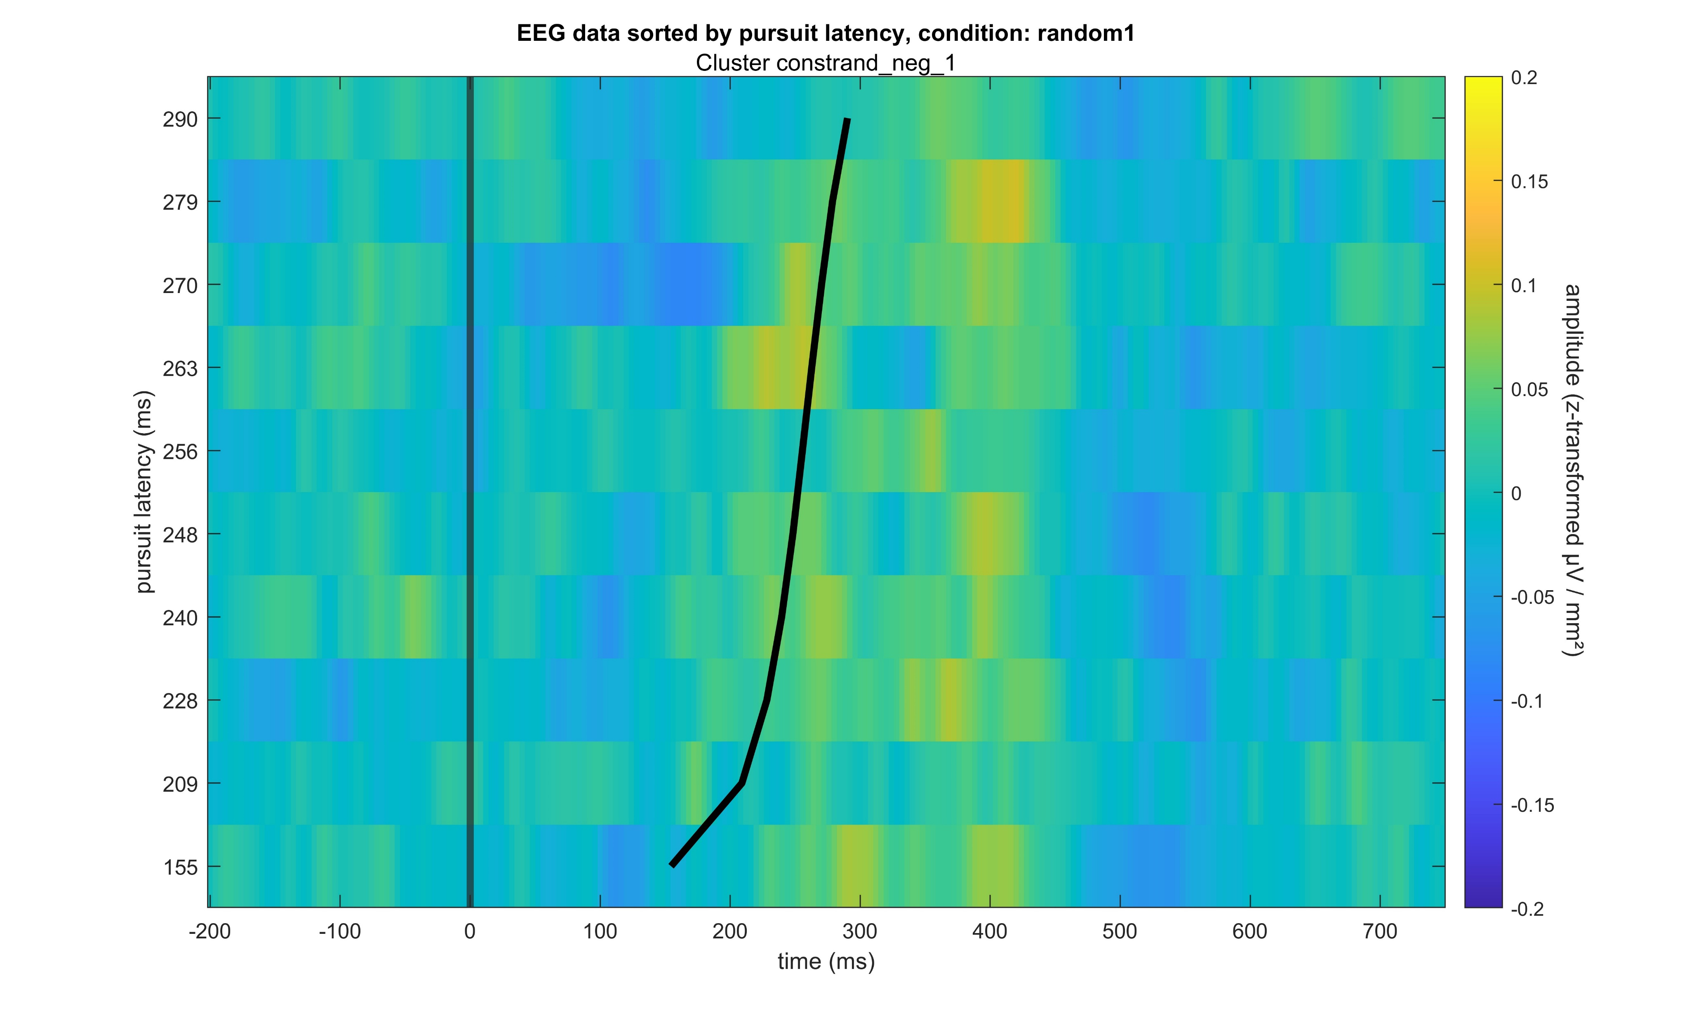
Constant – Random1 negative

Slide 8
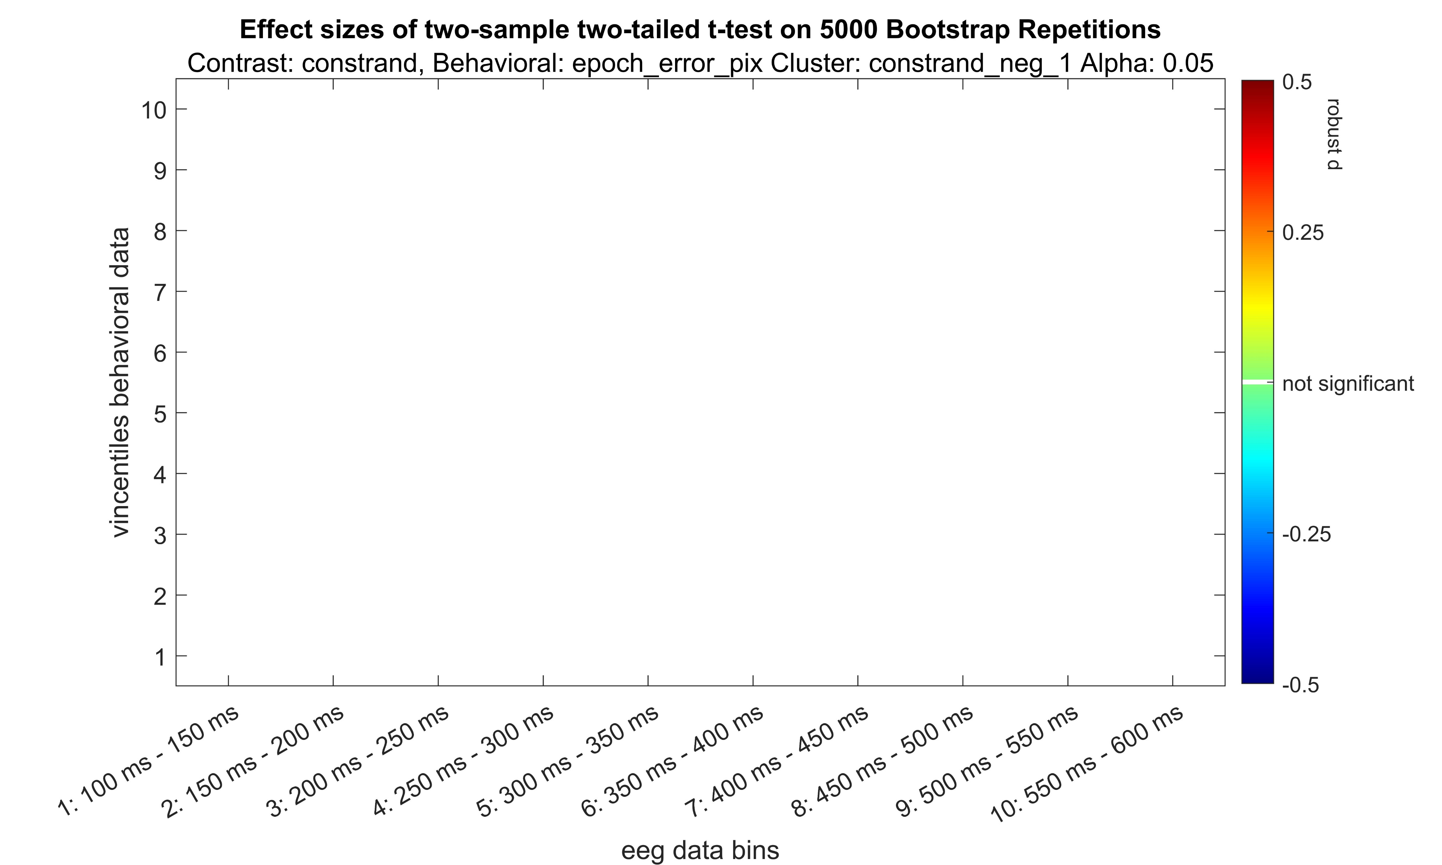
Constant – Random1 negative
Not actually robust, just normal cohen‘s d

Slide 9

Constant – Random1 negative

Slide 10
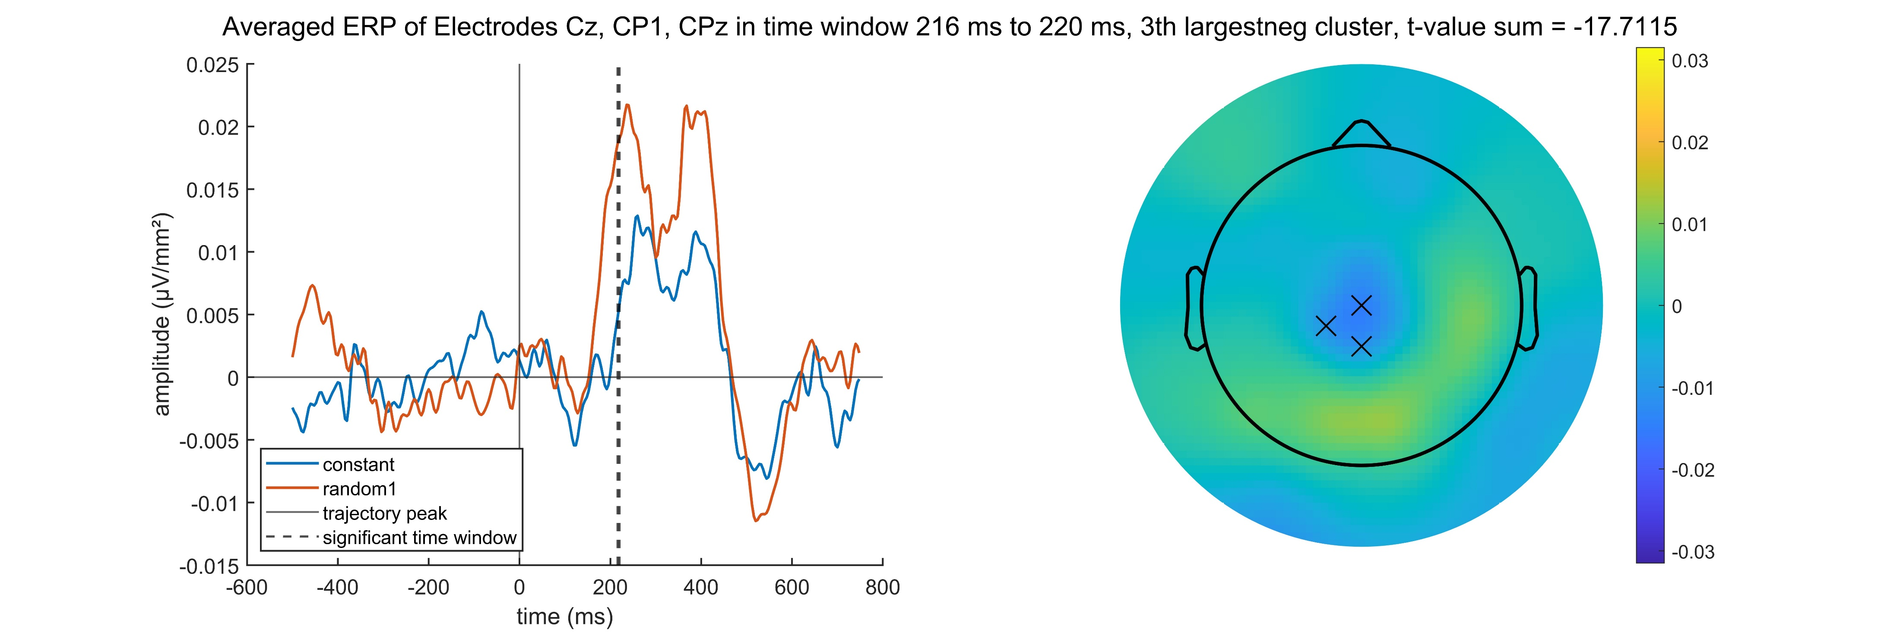
Constant – Random1 negative

Slide 11
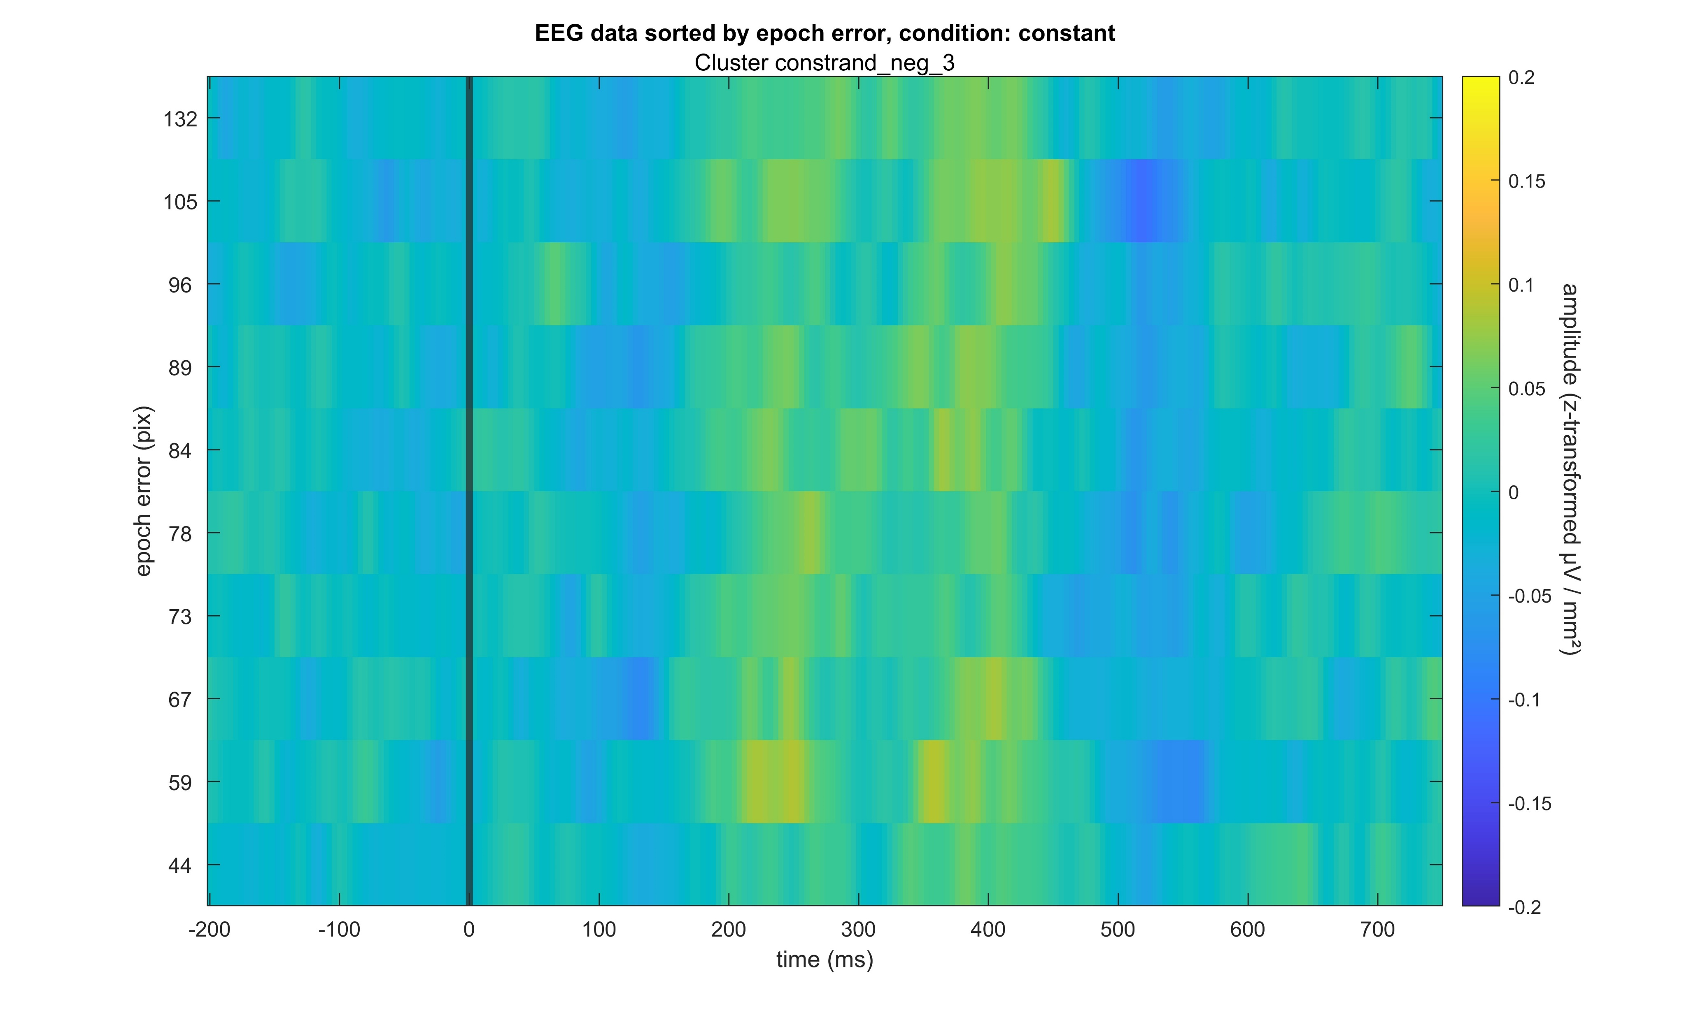
Constant – Random1 negative

Slide 12
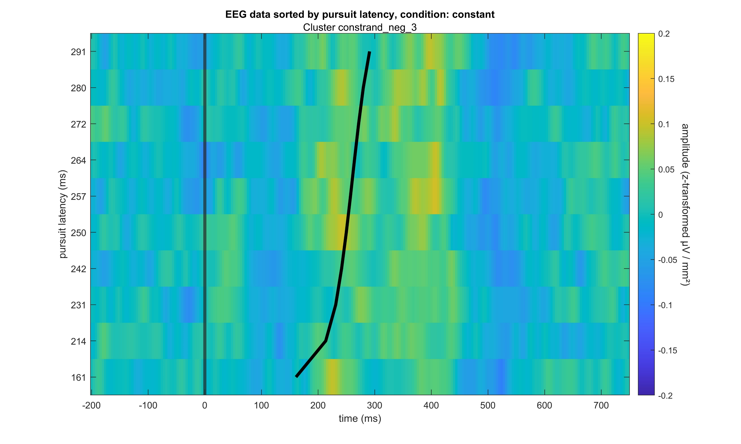
Constant – Random1 negative

Slide 13
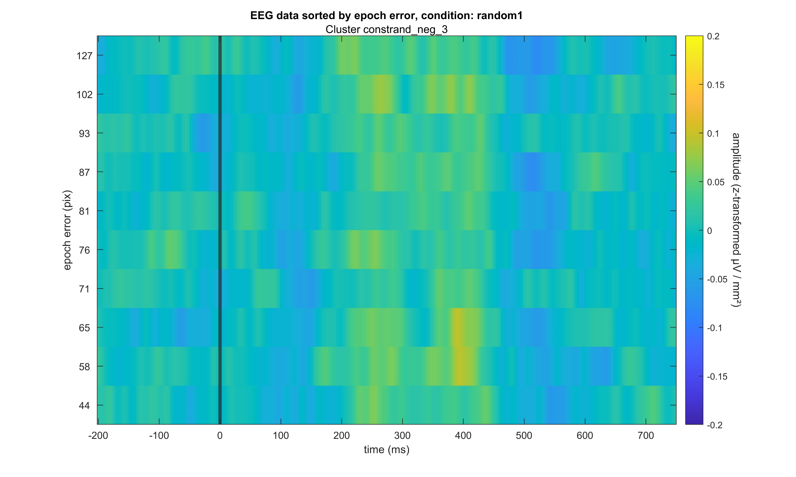
Constant – Random1 negative

Slide 14
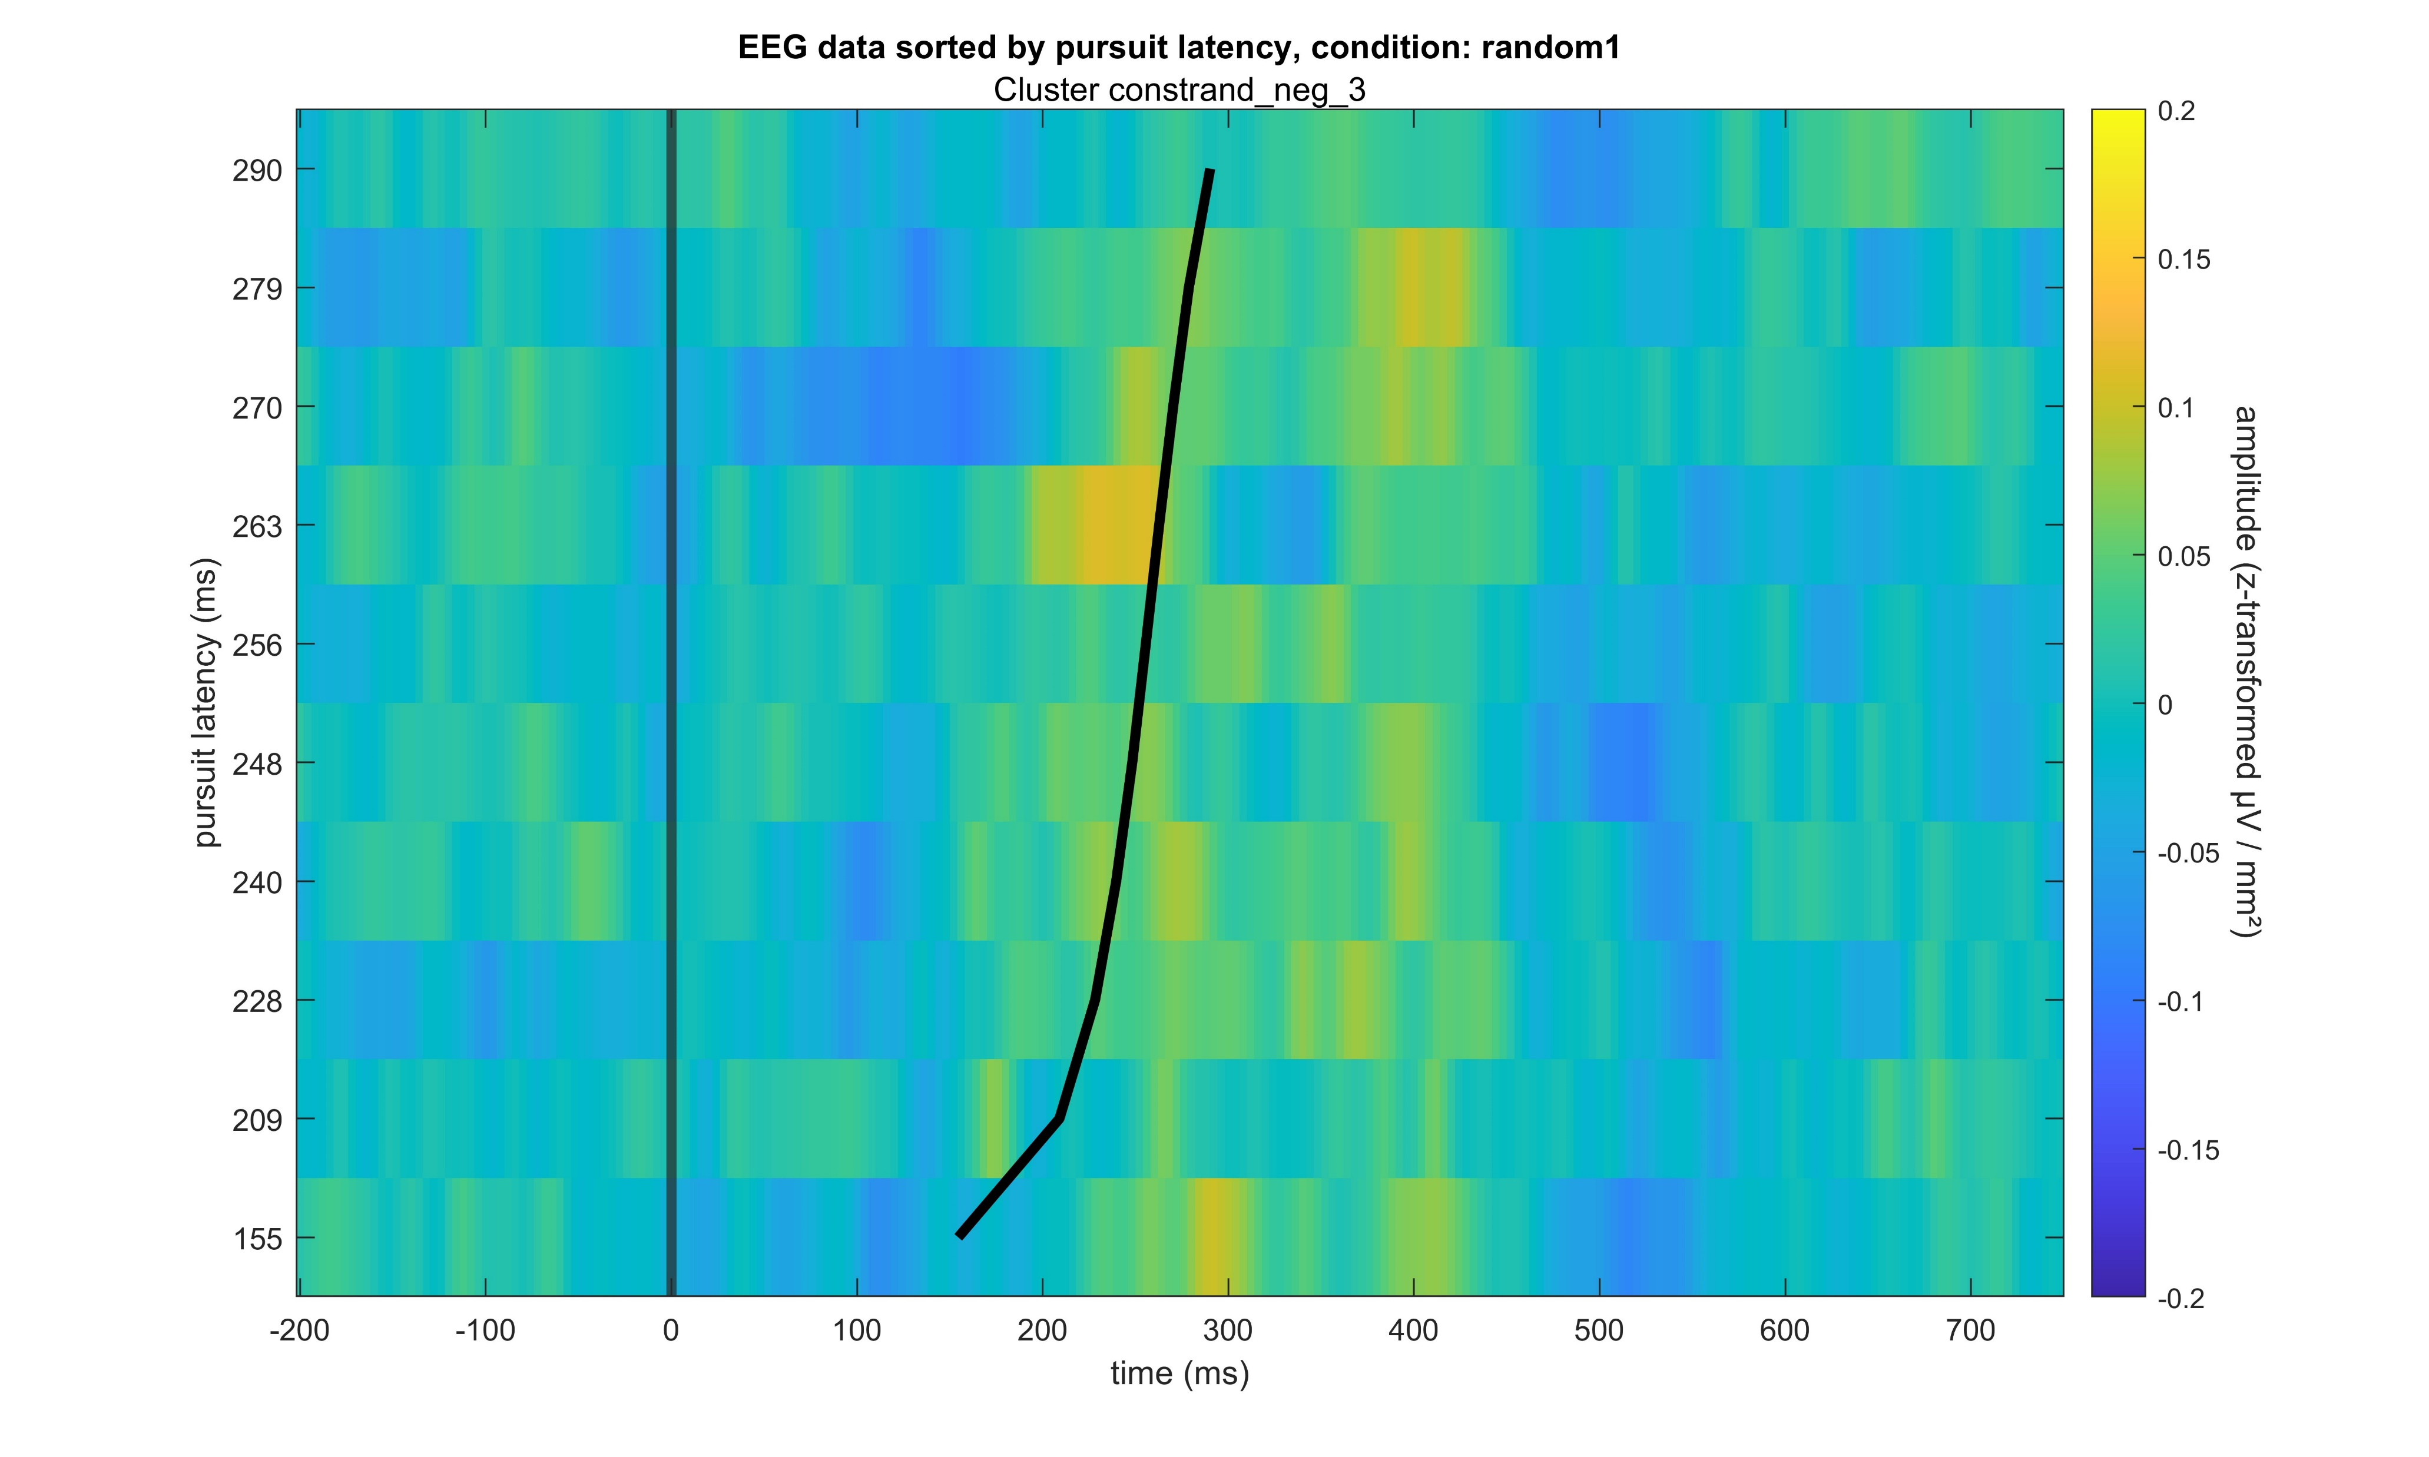
Constant – Random1 negative

Slide 15

Constant – Random1 negative

Slide 16

Constant – Random1 negative

Slide 17
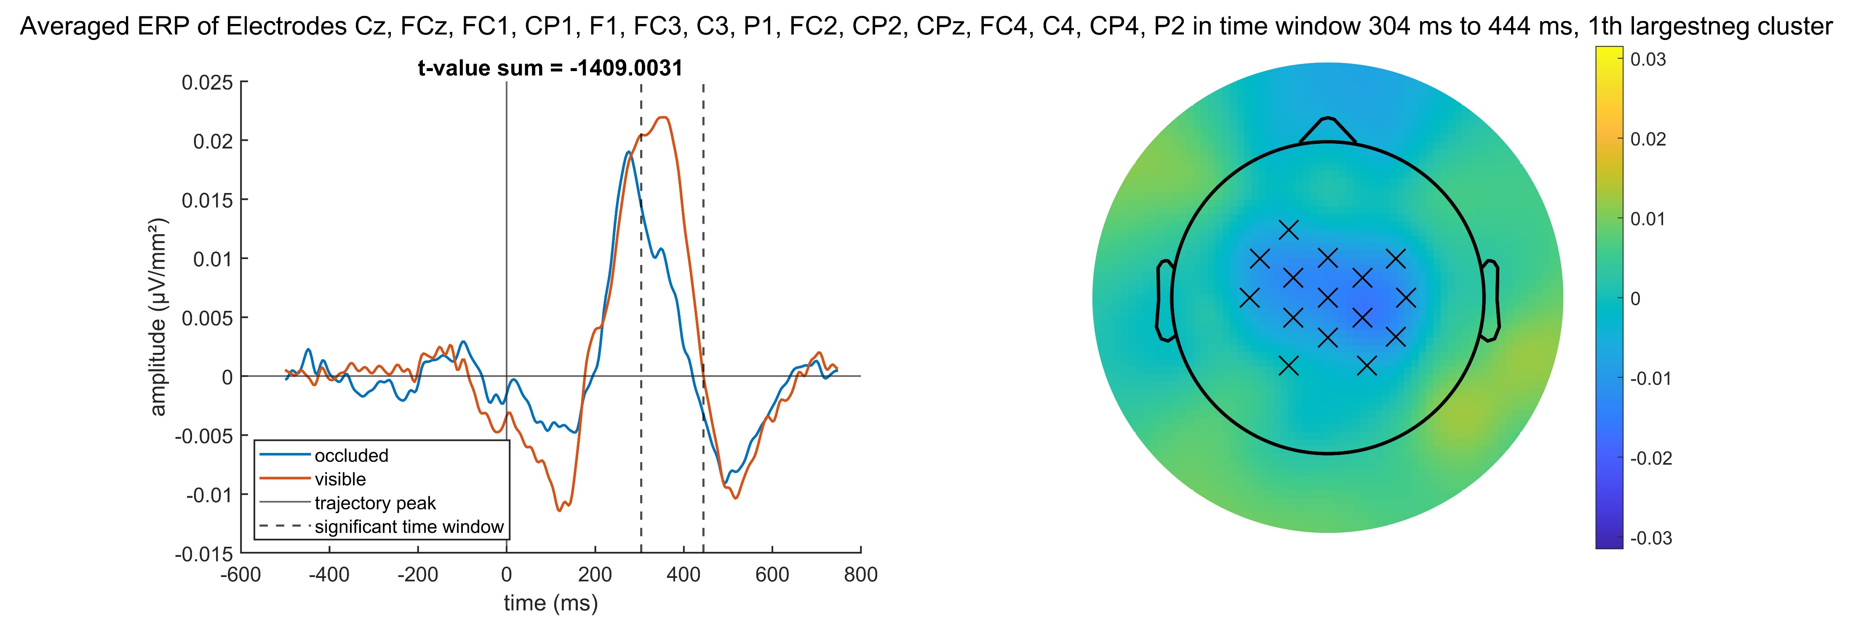
Occluded – Visible negative

Slide 18
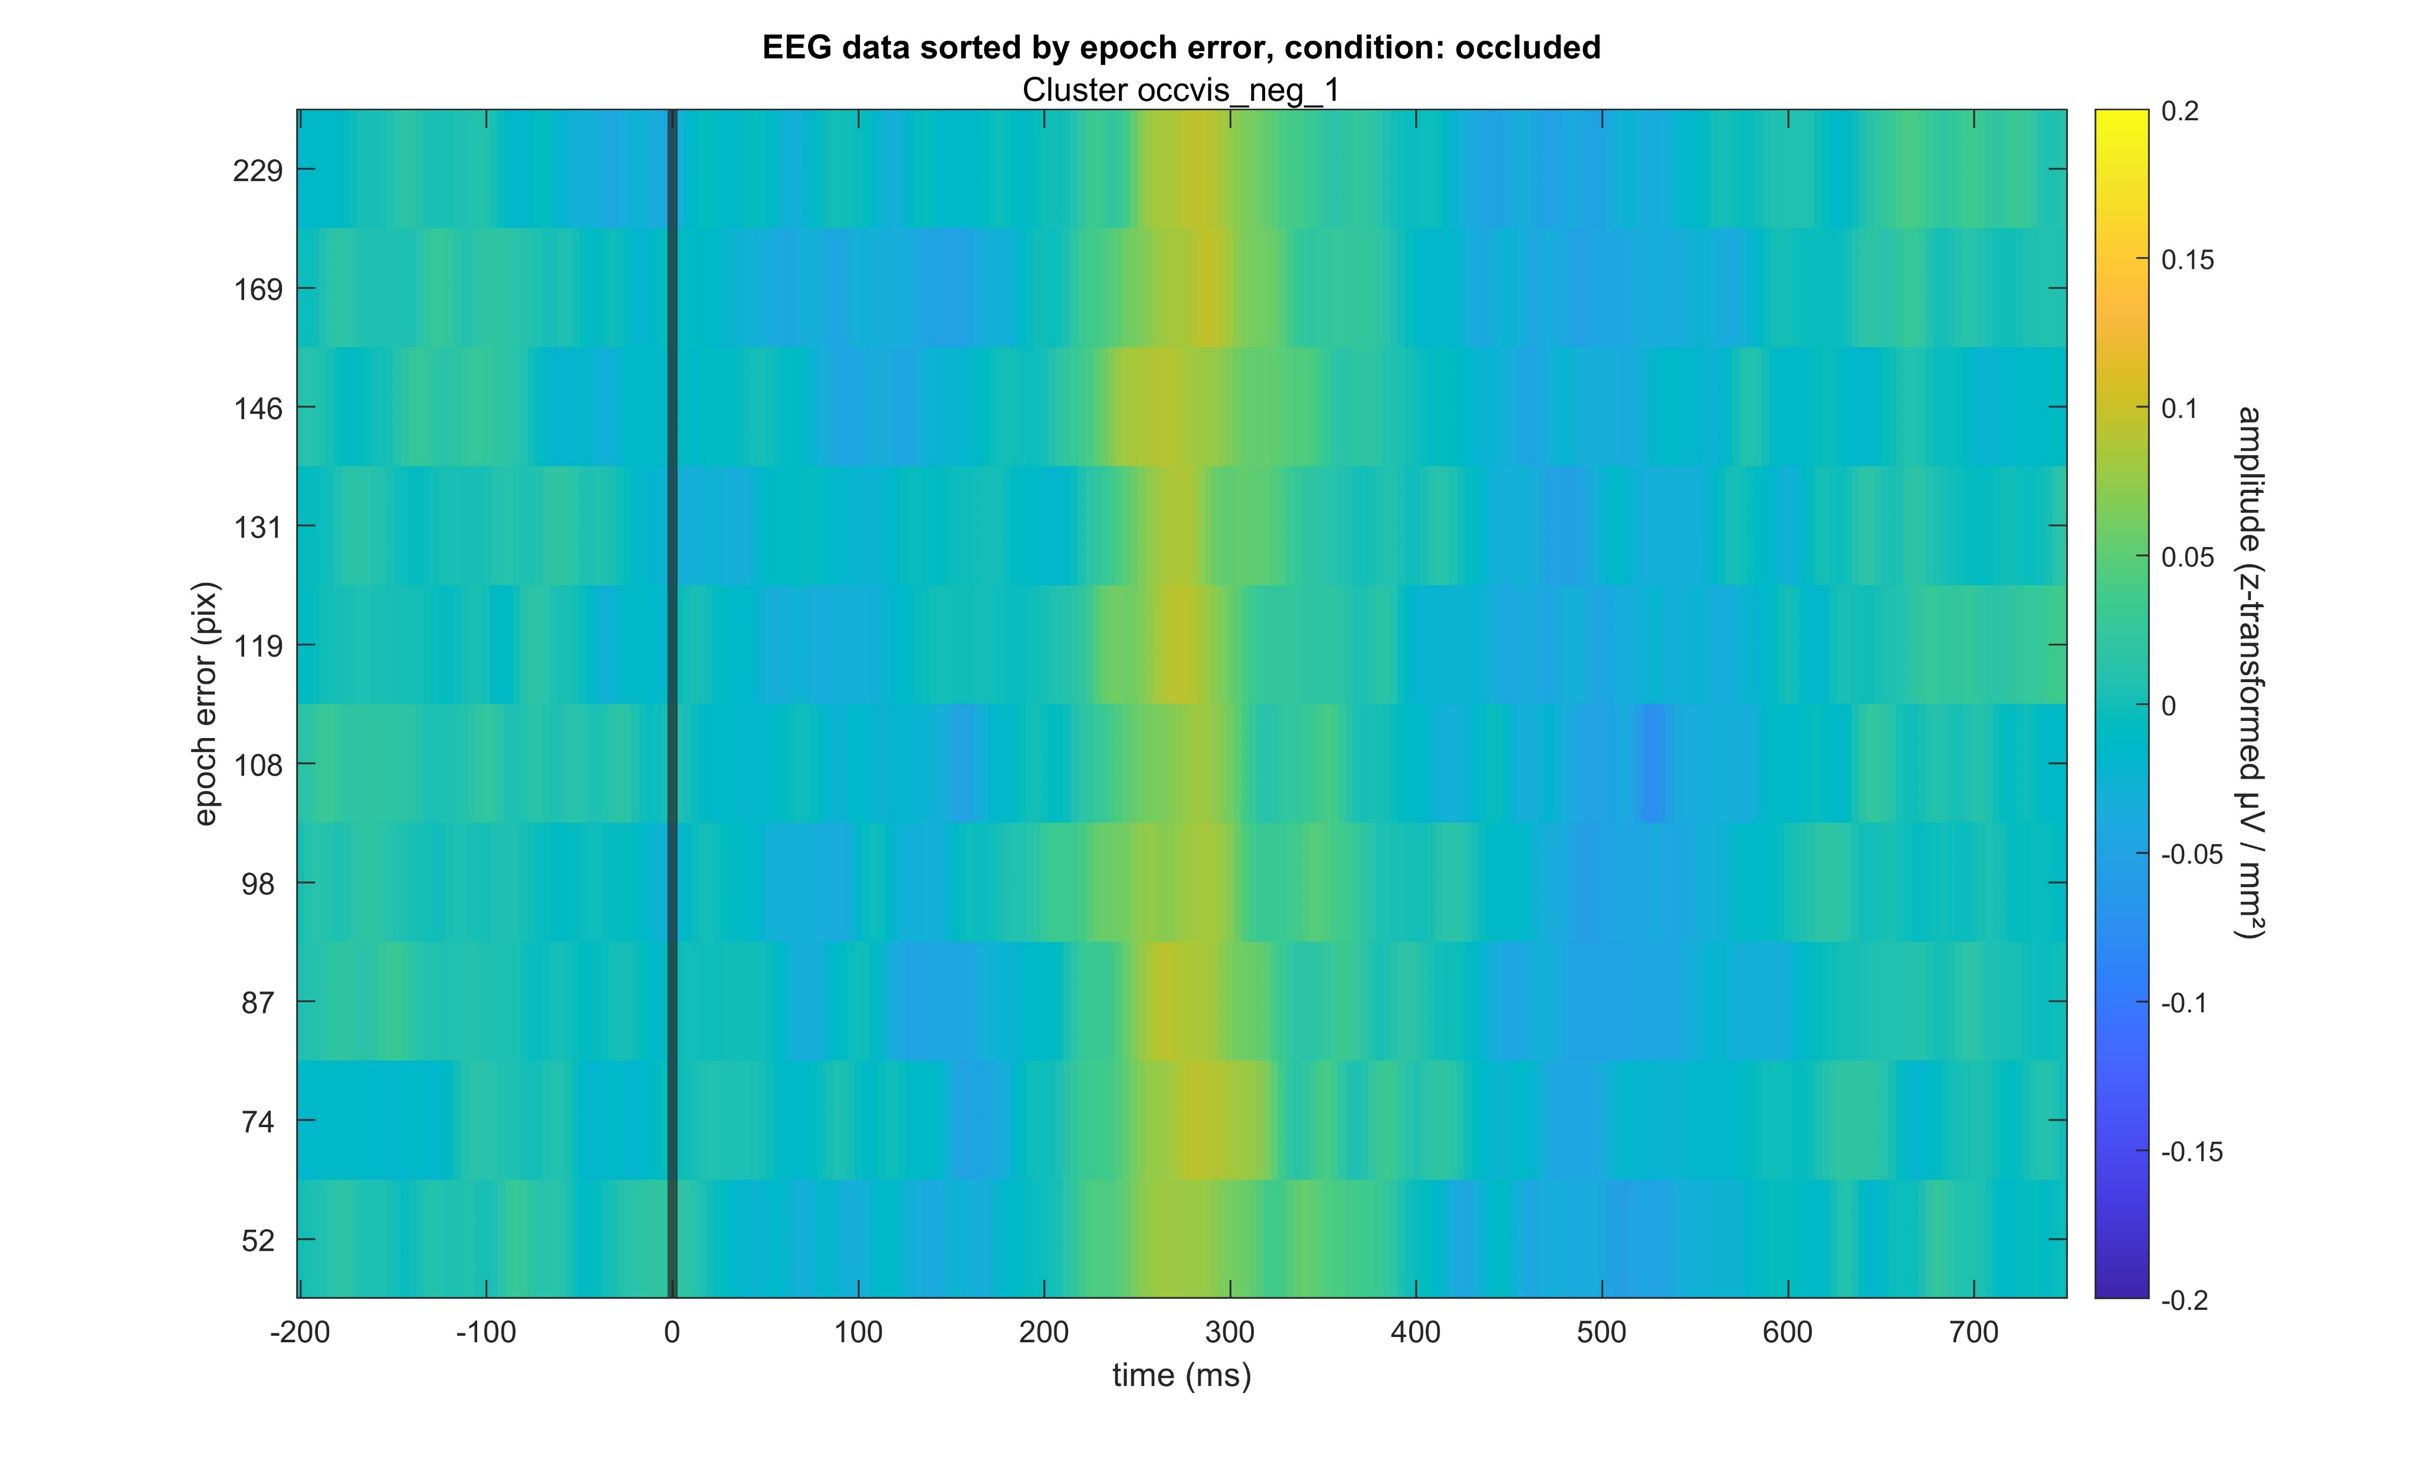
Occluded – Visible negative

Slide 19
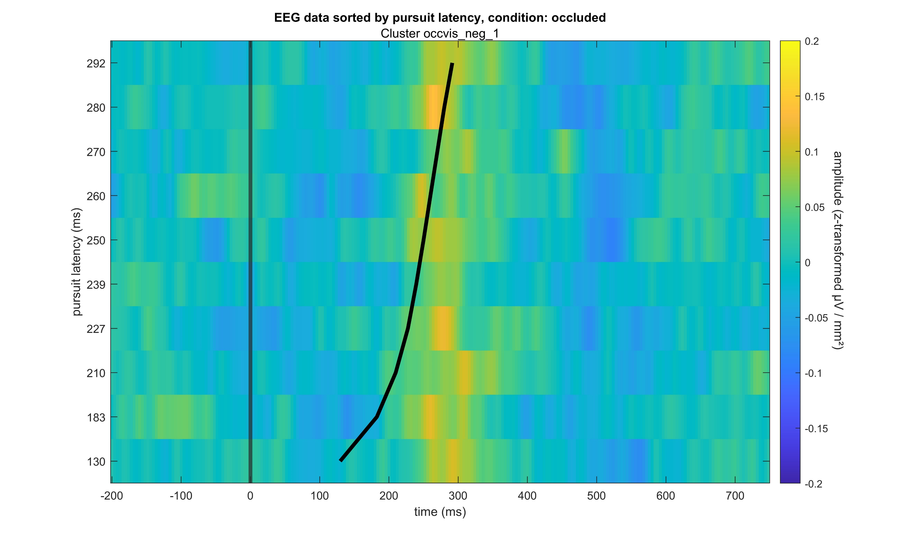
Occluded – Visible negative

Slide 20
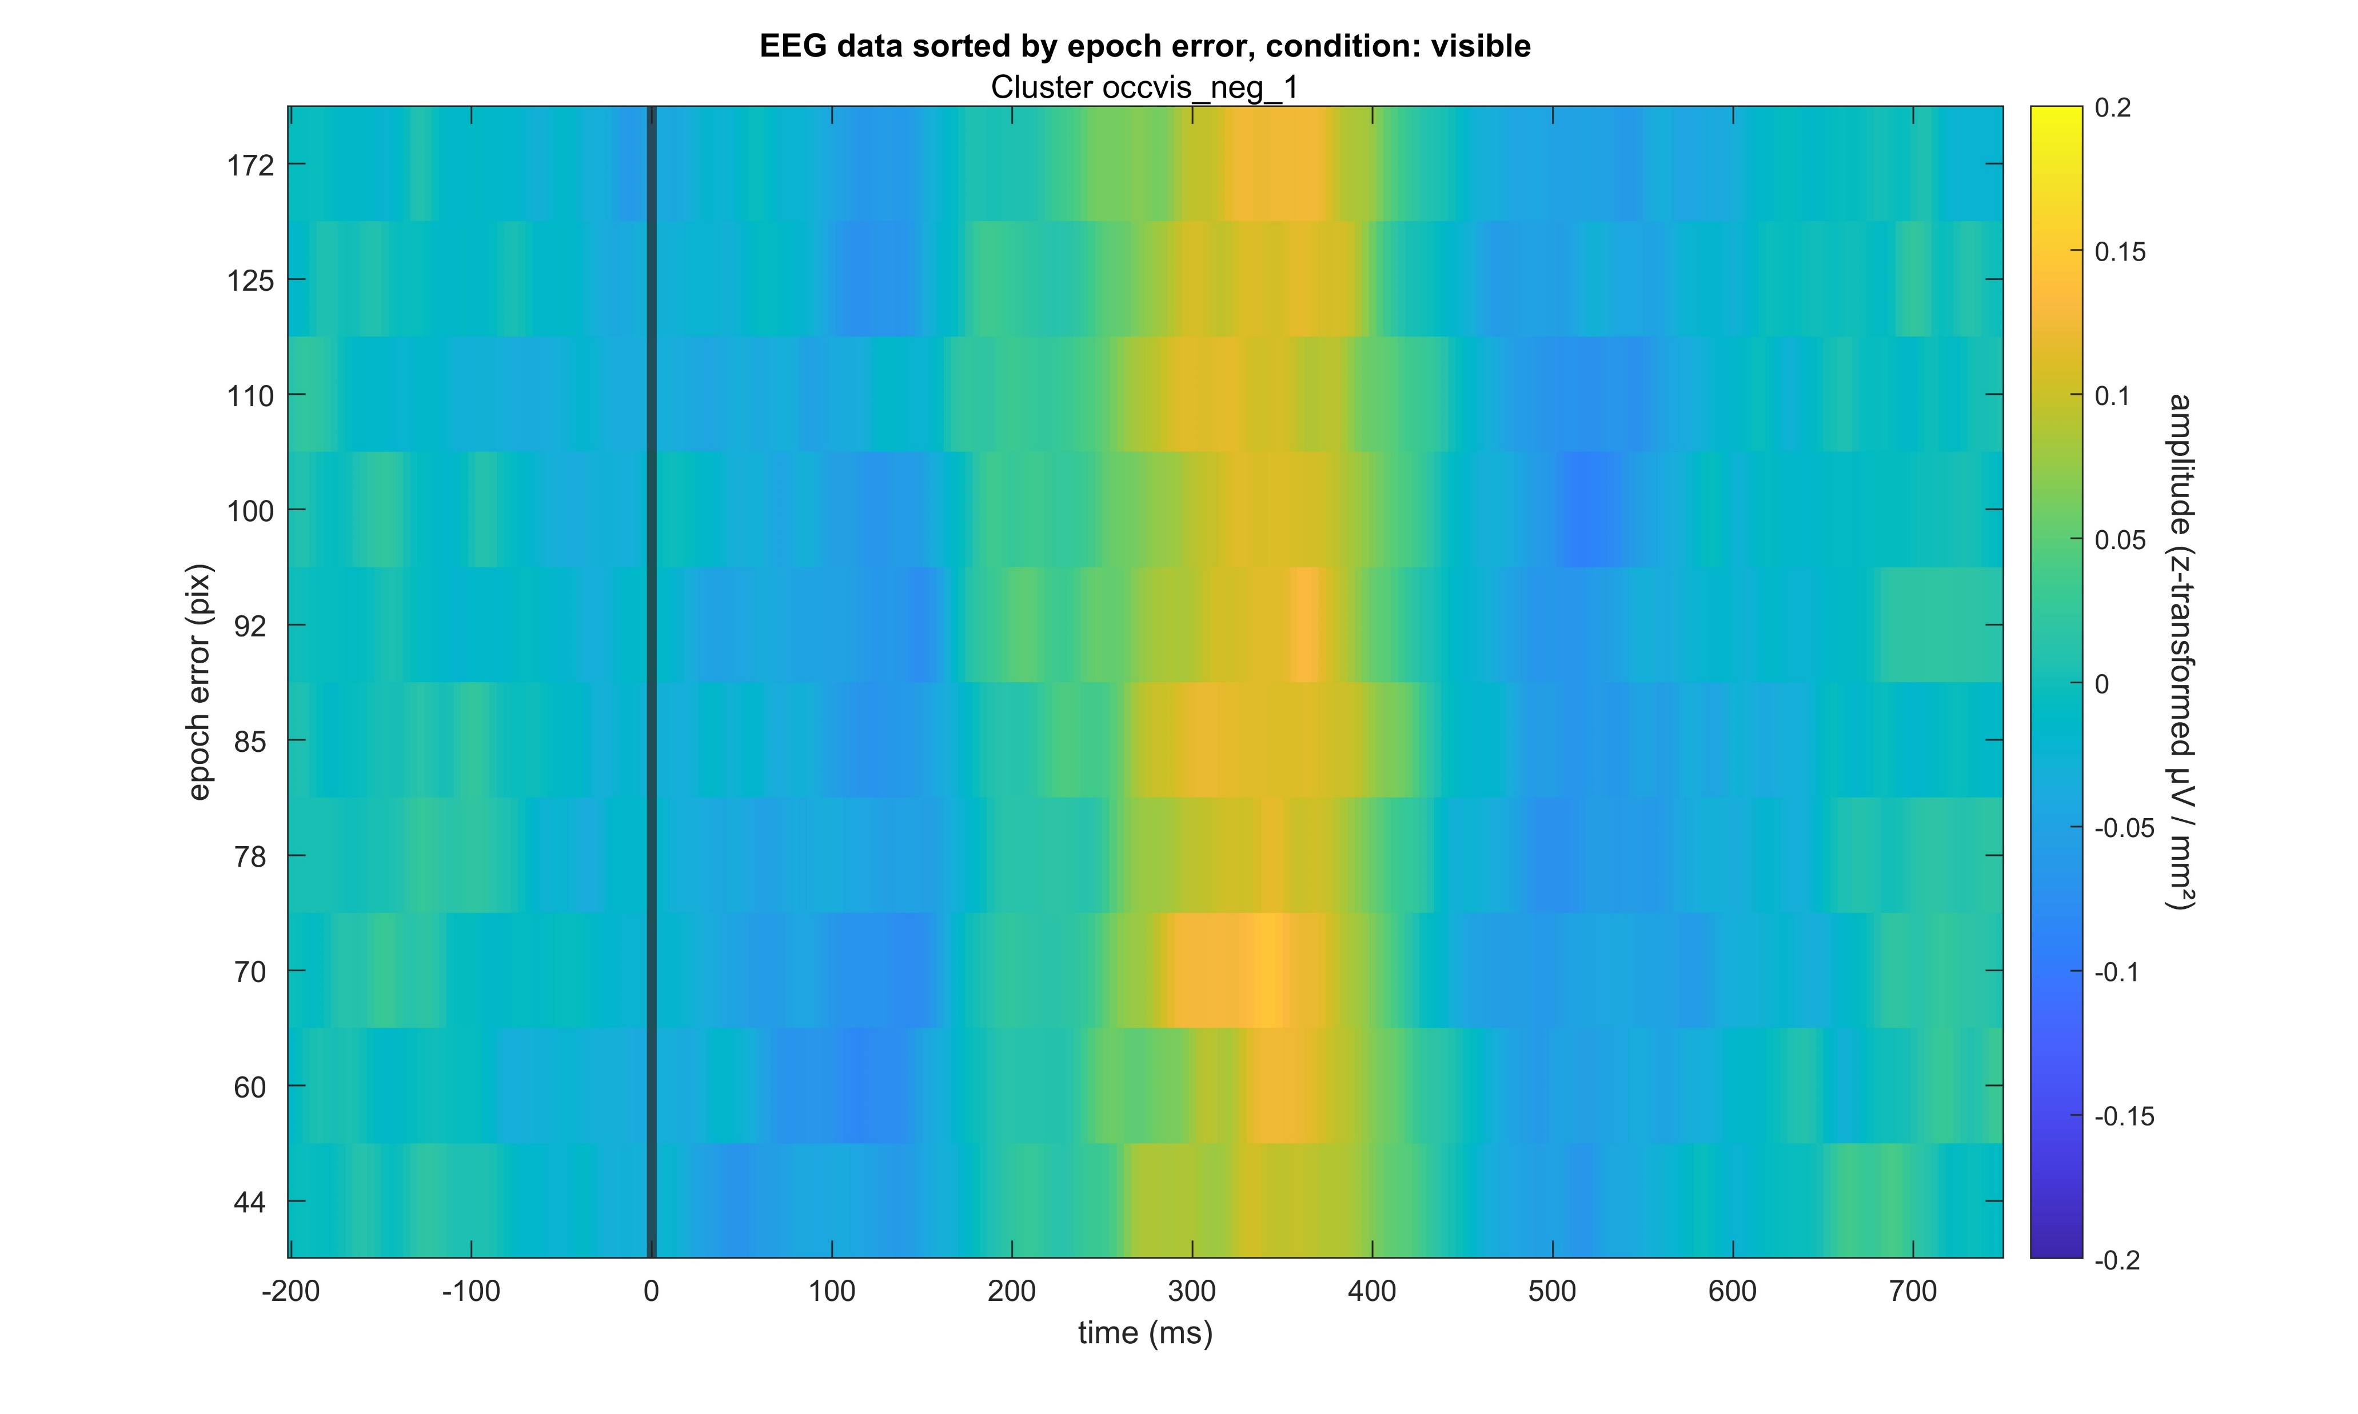
Occluded – Visible negative

Slide 21
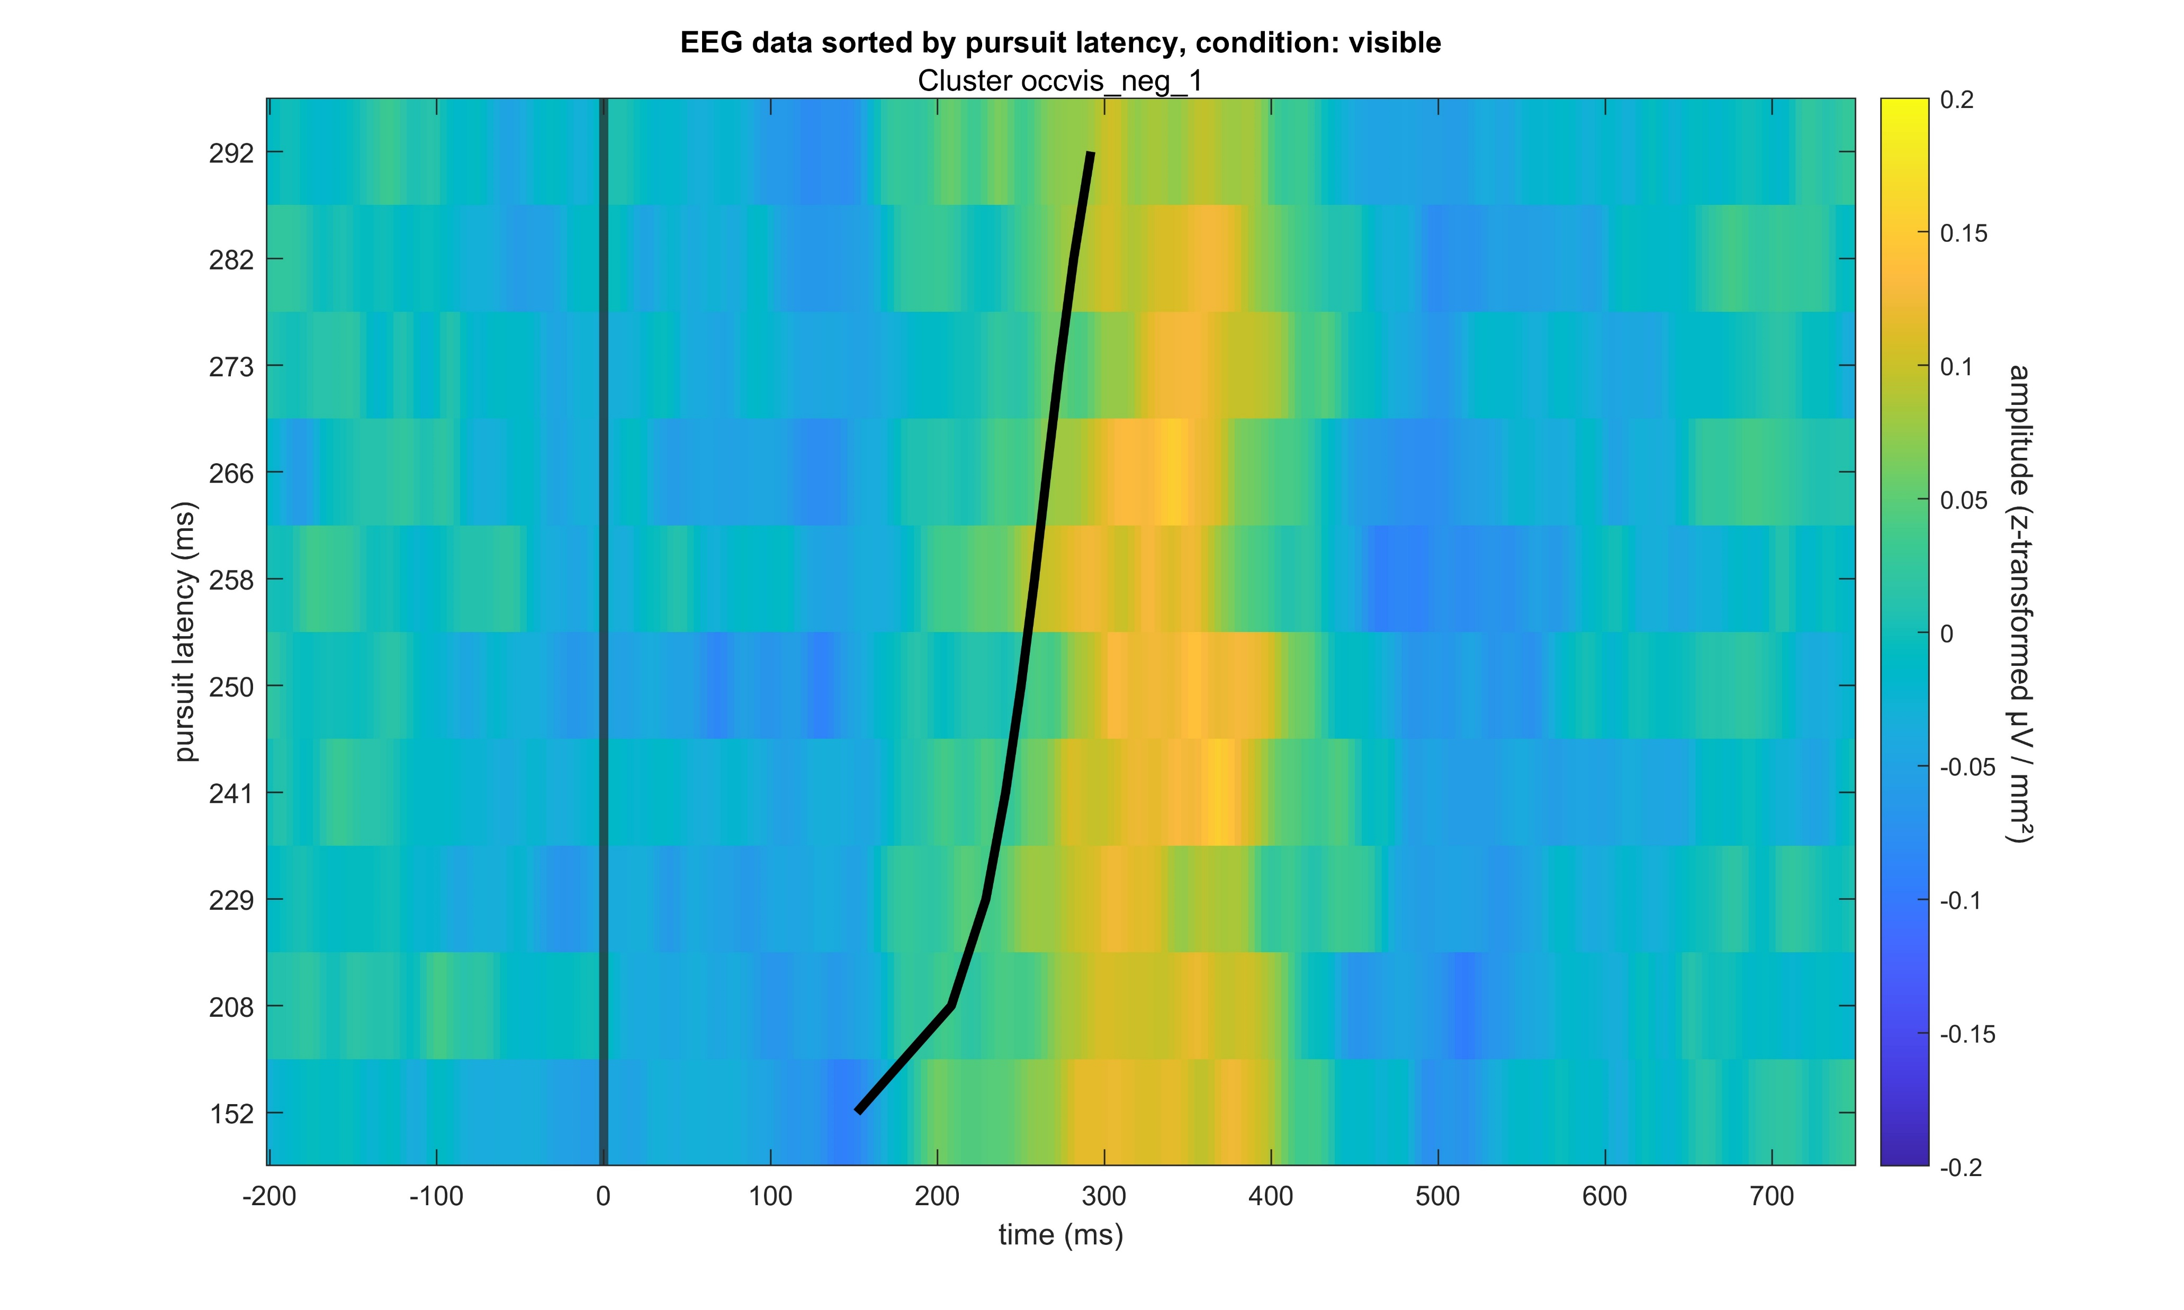
Occluded – Visible negative

Slide 22
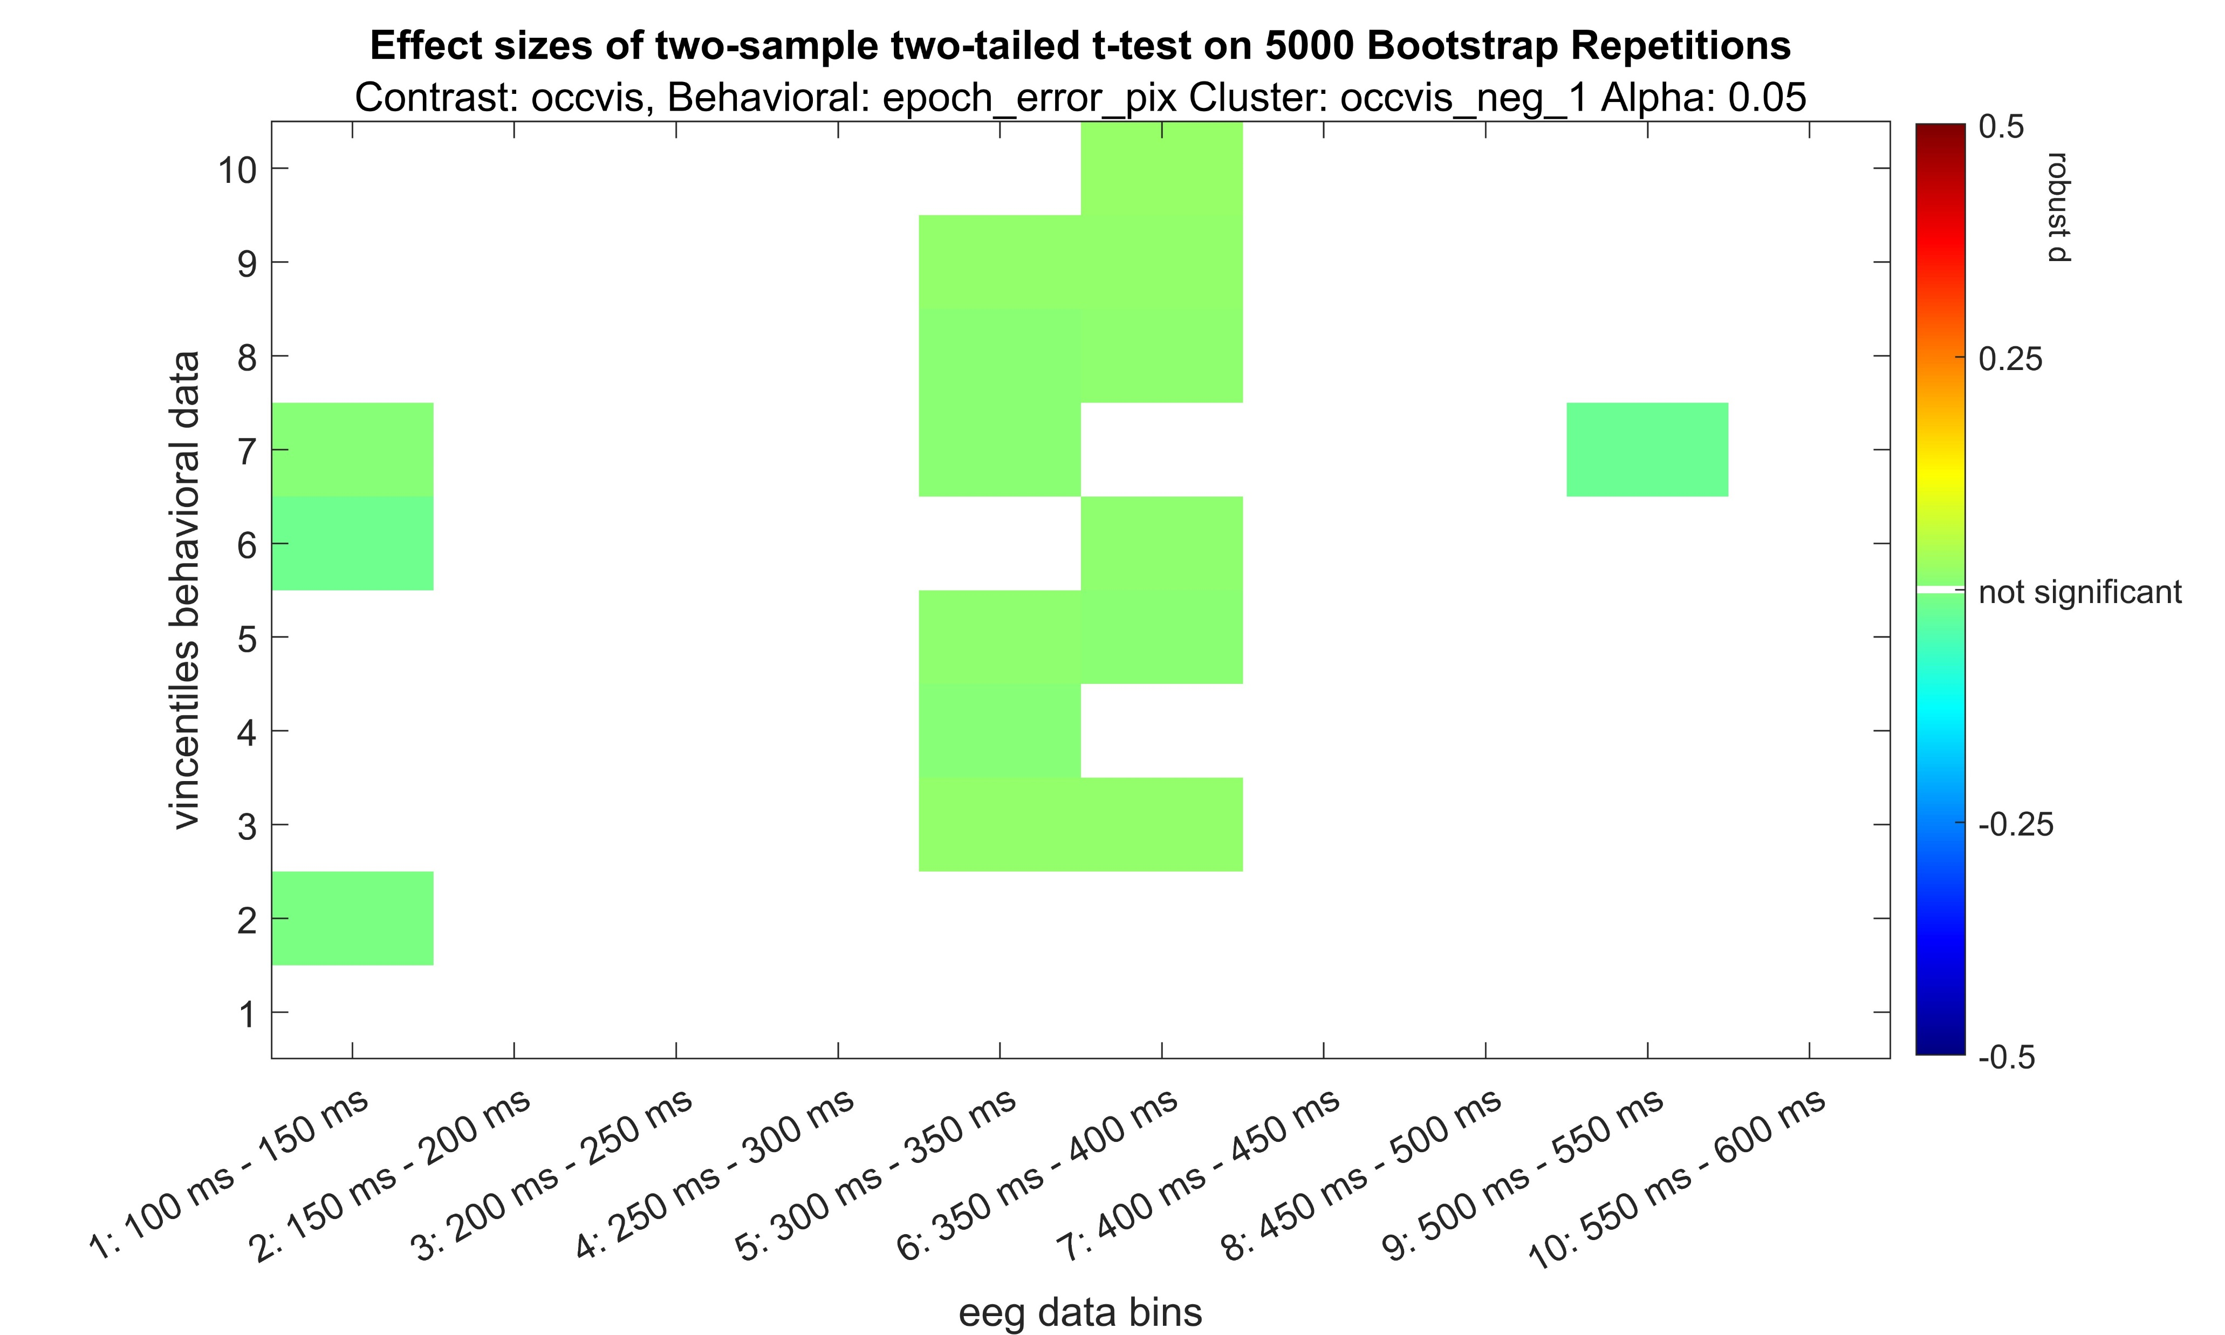
Occluded – Visible negative

Slide 23
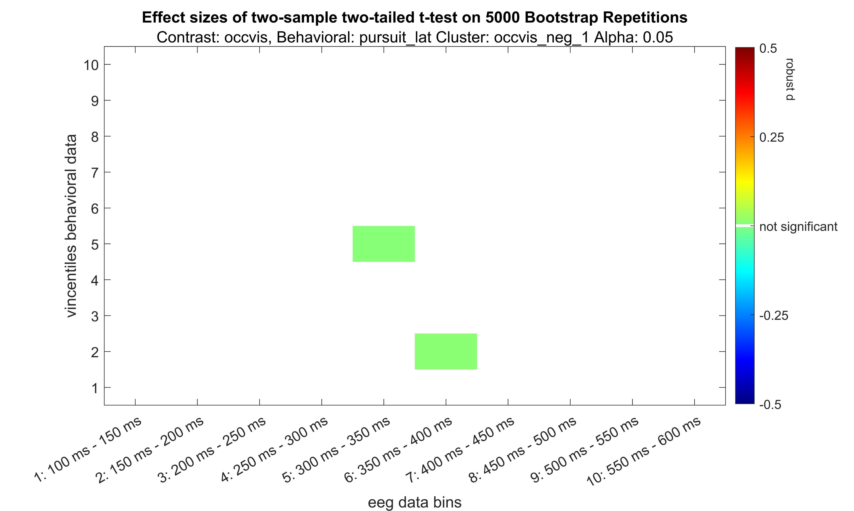
Occluded – Visible negative

Slide 24
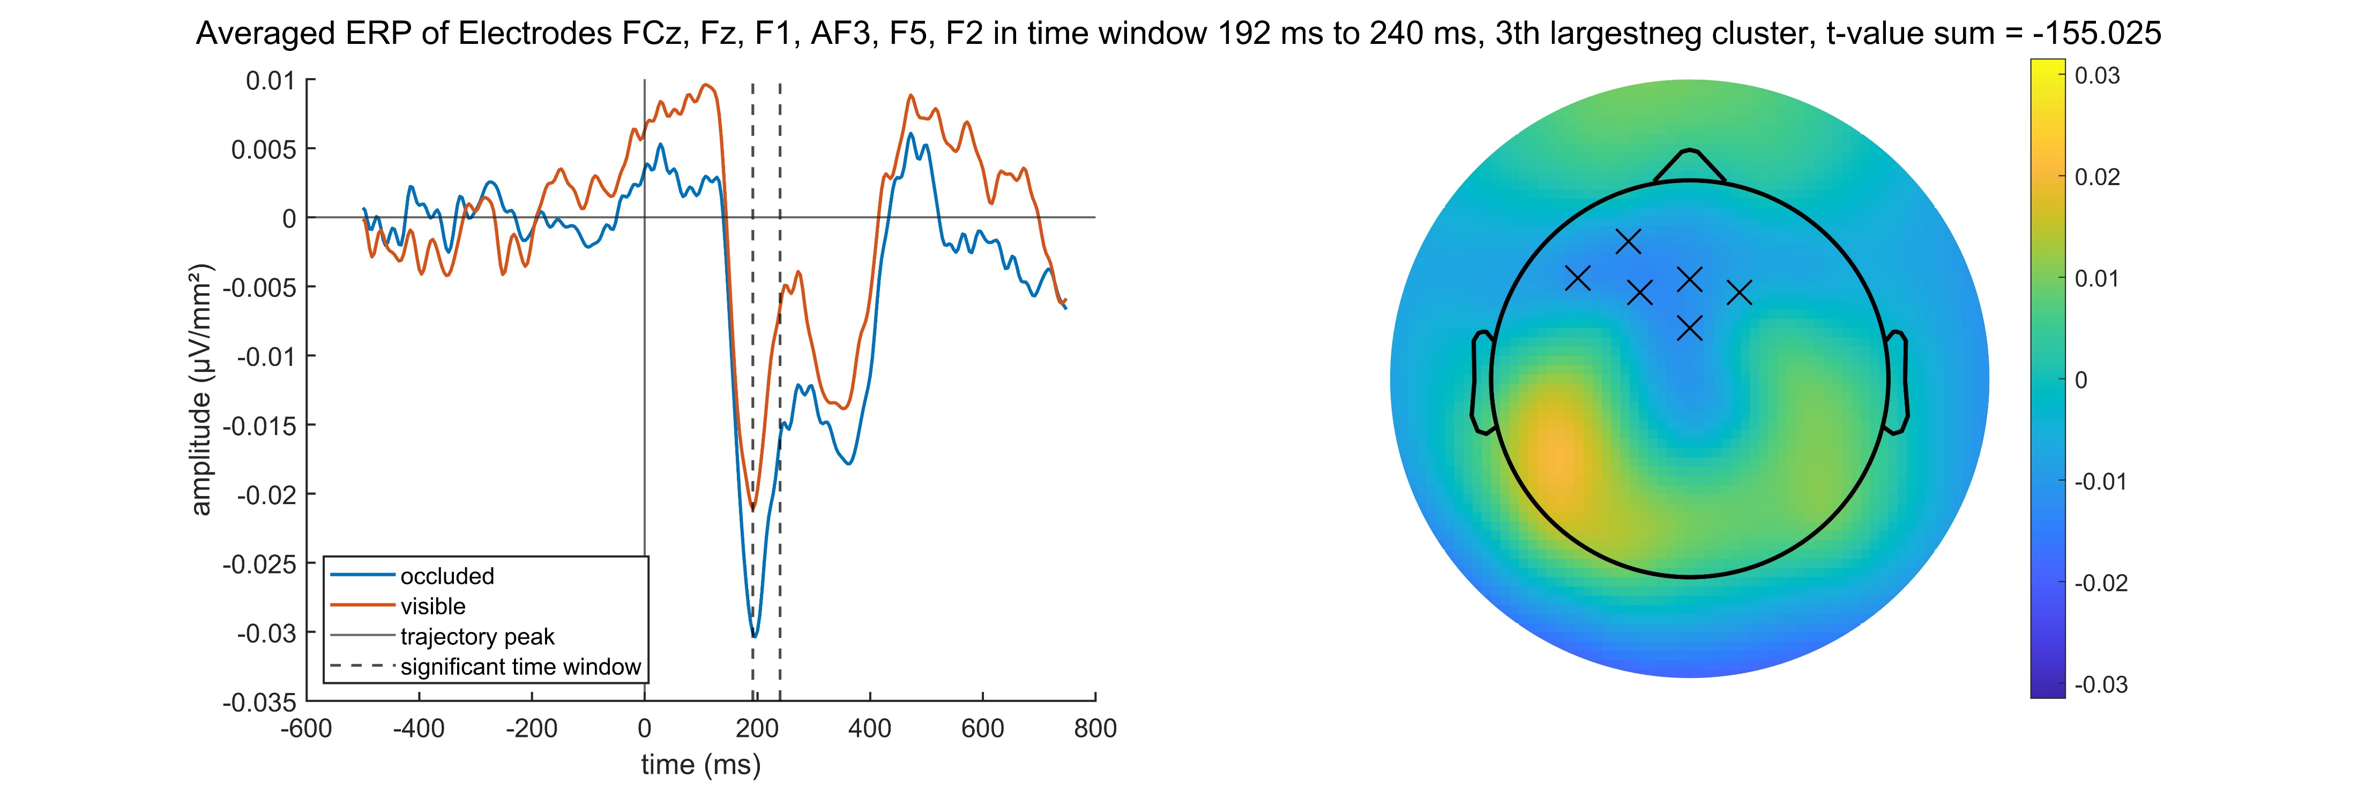
Occluded – Visible negative

Slide 25

Occluded – Visible negative

Slide 26
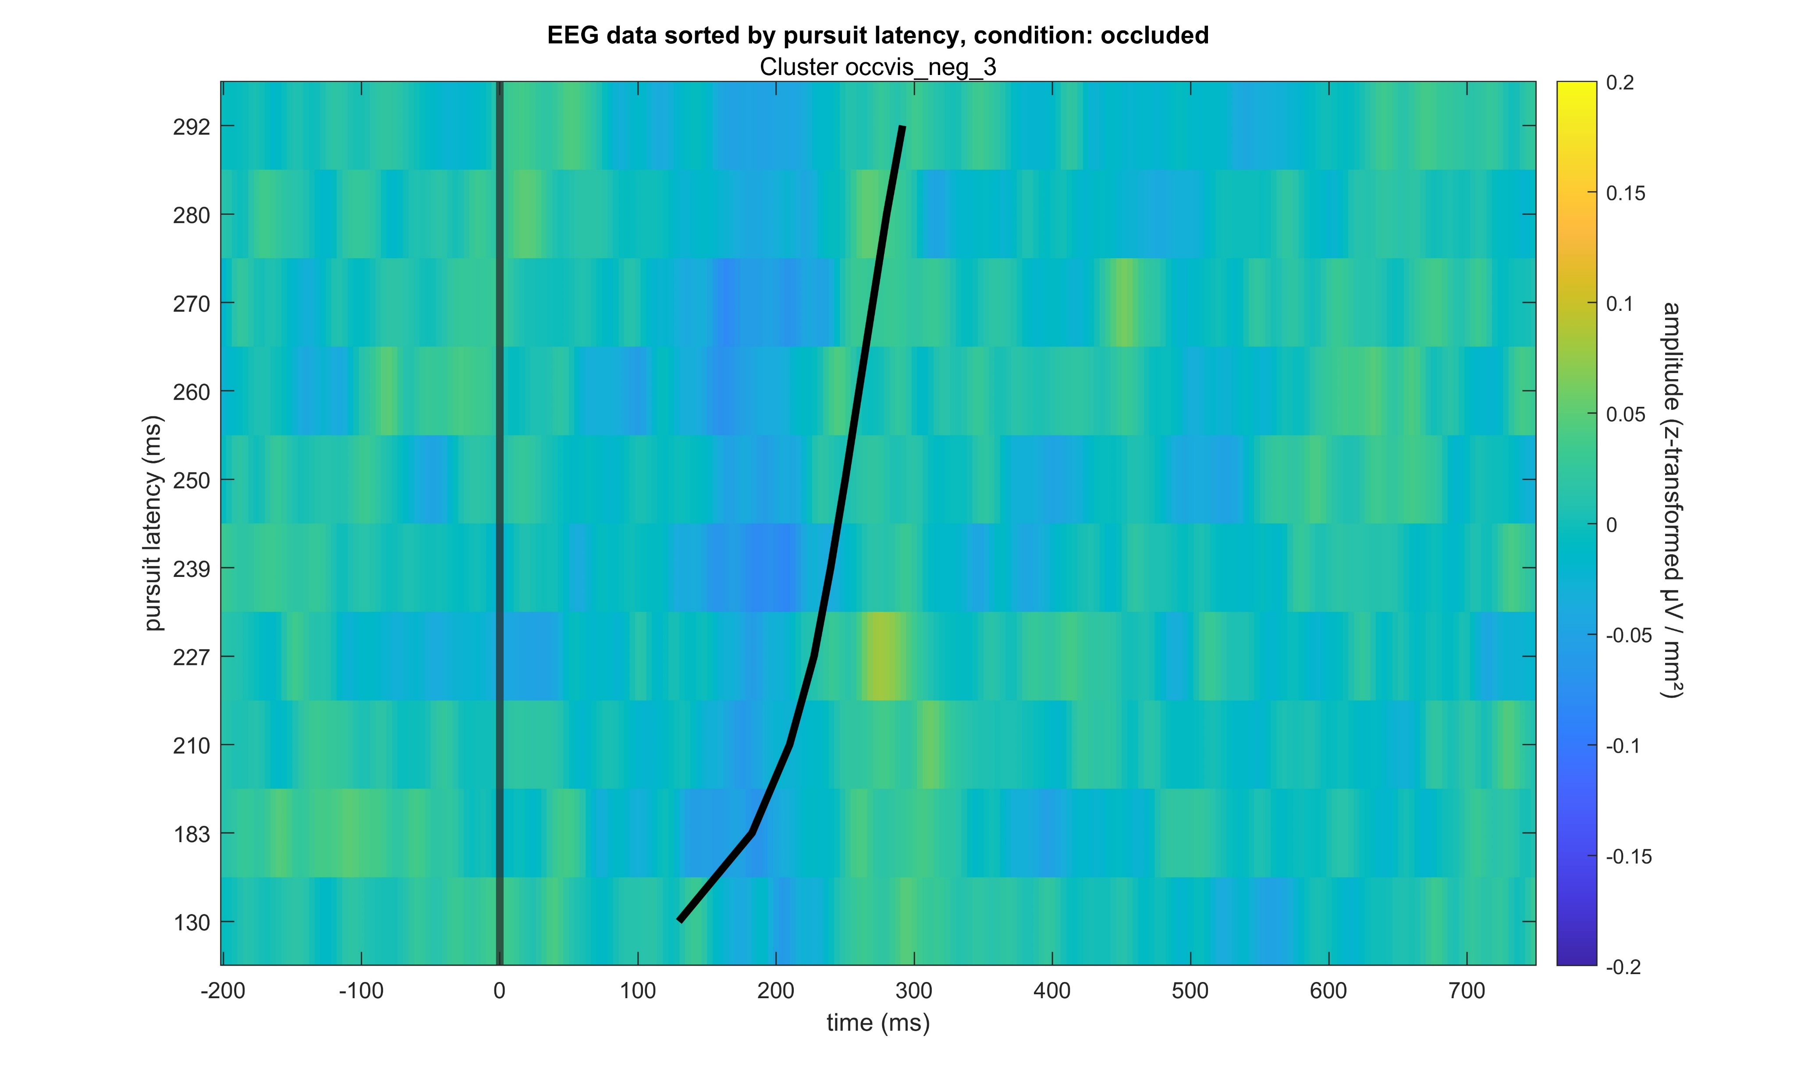
Occluded – Visible negative

Slide 27
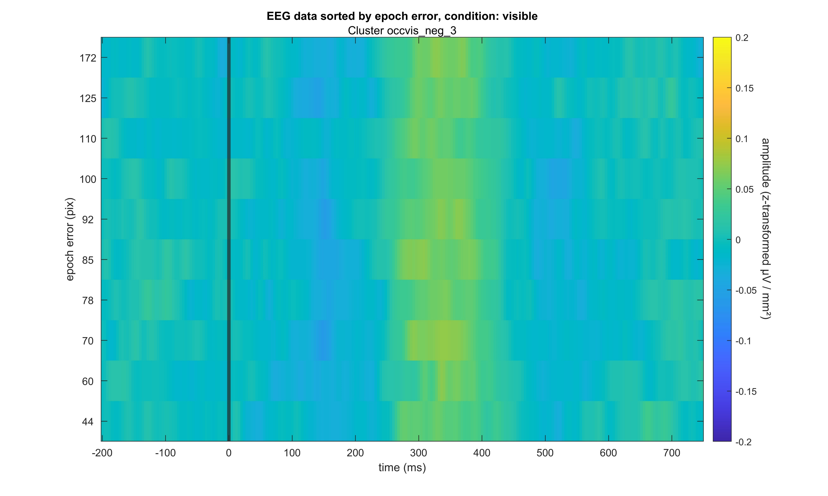
Occluded – Visible negative

Slide 28
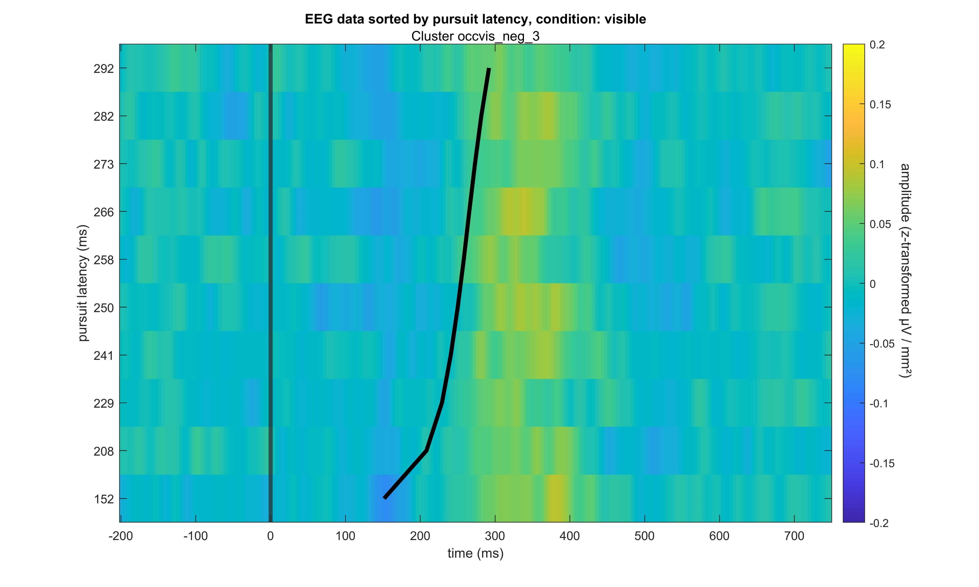
Occluded – Visible negative

Slide 29
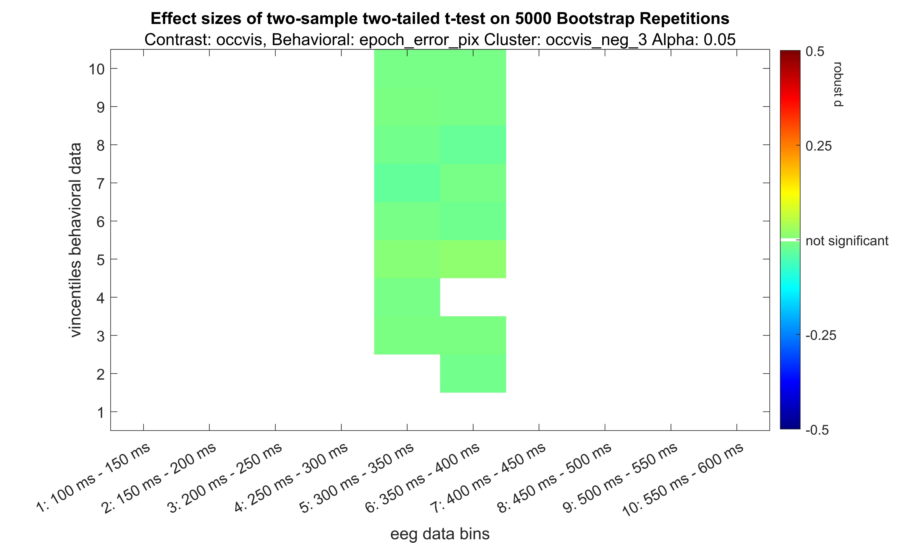
Occluded – Visible negative

Slide 30
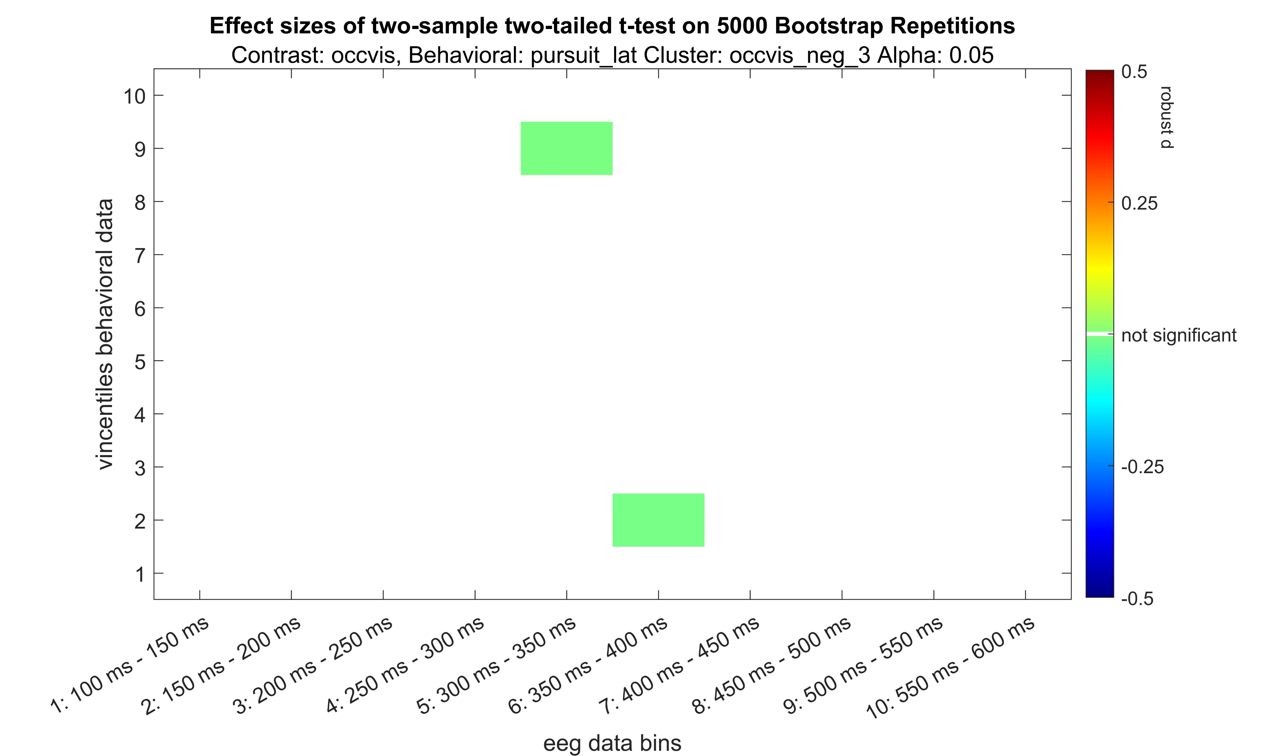
Occluded – Visible negative

Slide 31
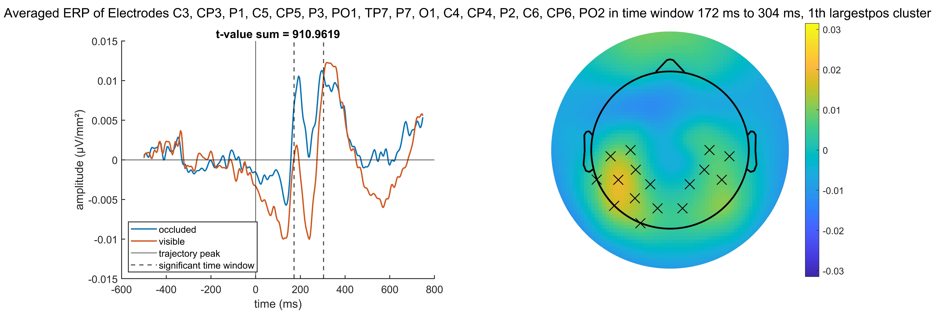
Occluded – Visible positive

Slide 32
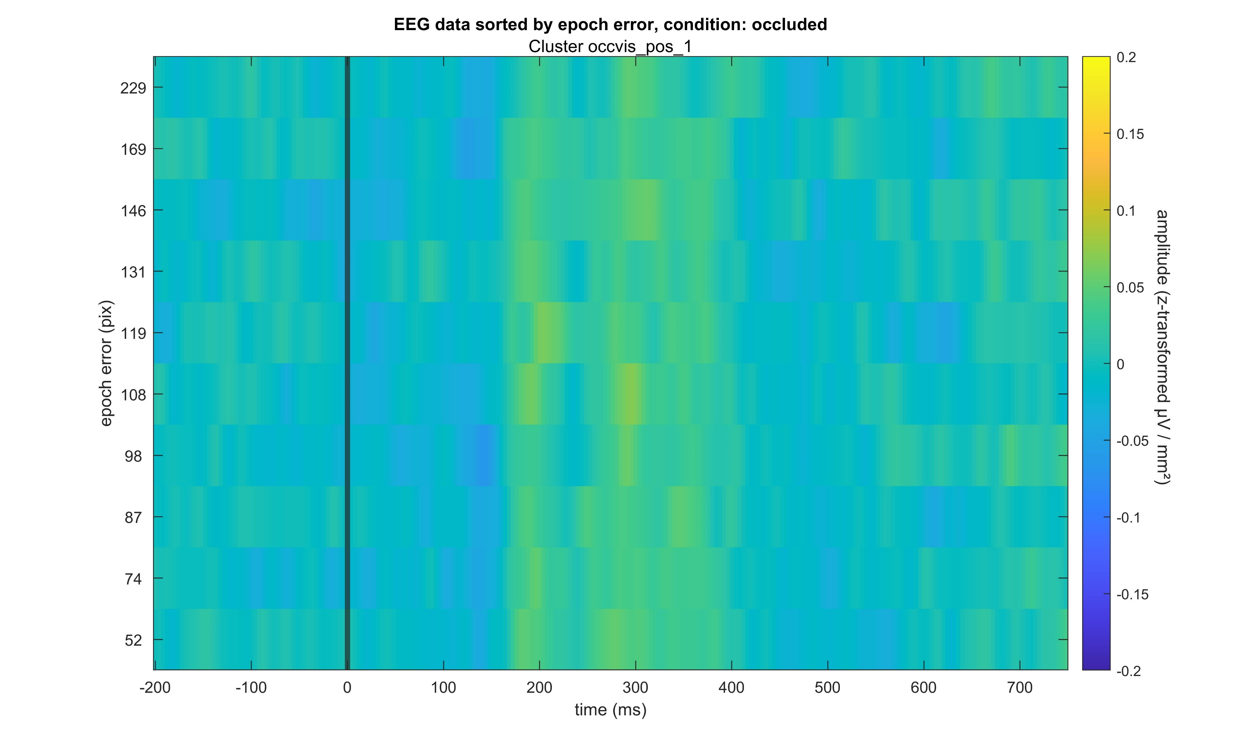
Occluded – Visible positive

Slide 33
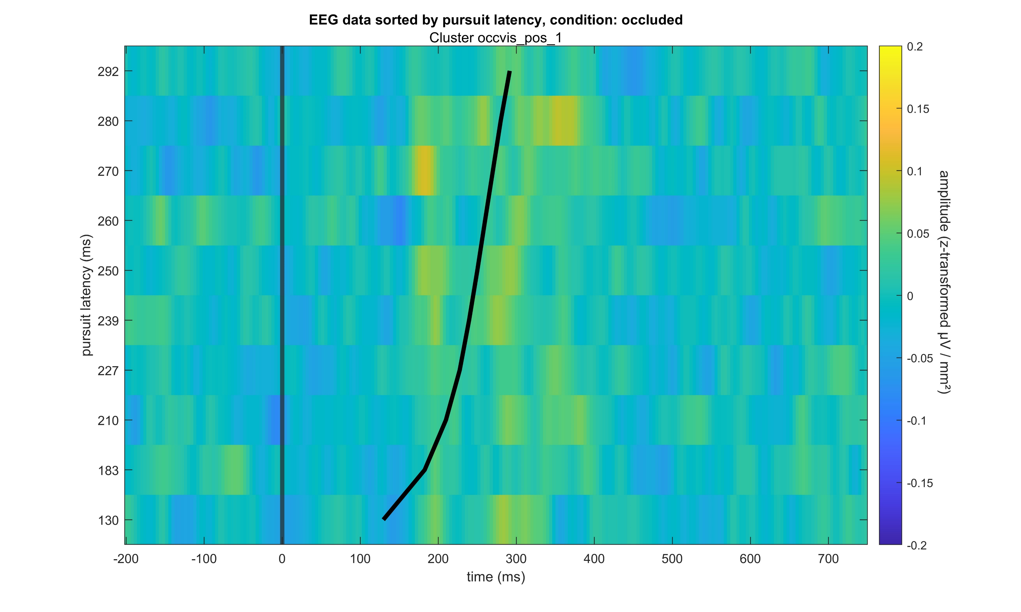
Occluded – Visible positive

Slide 34
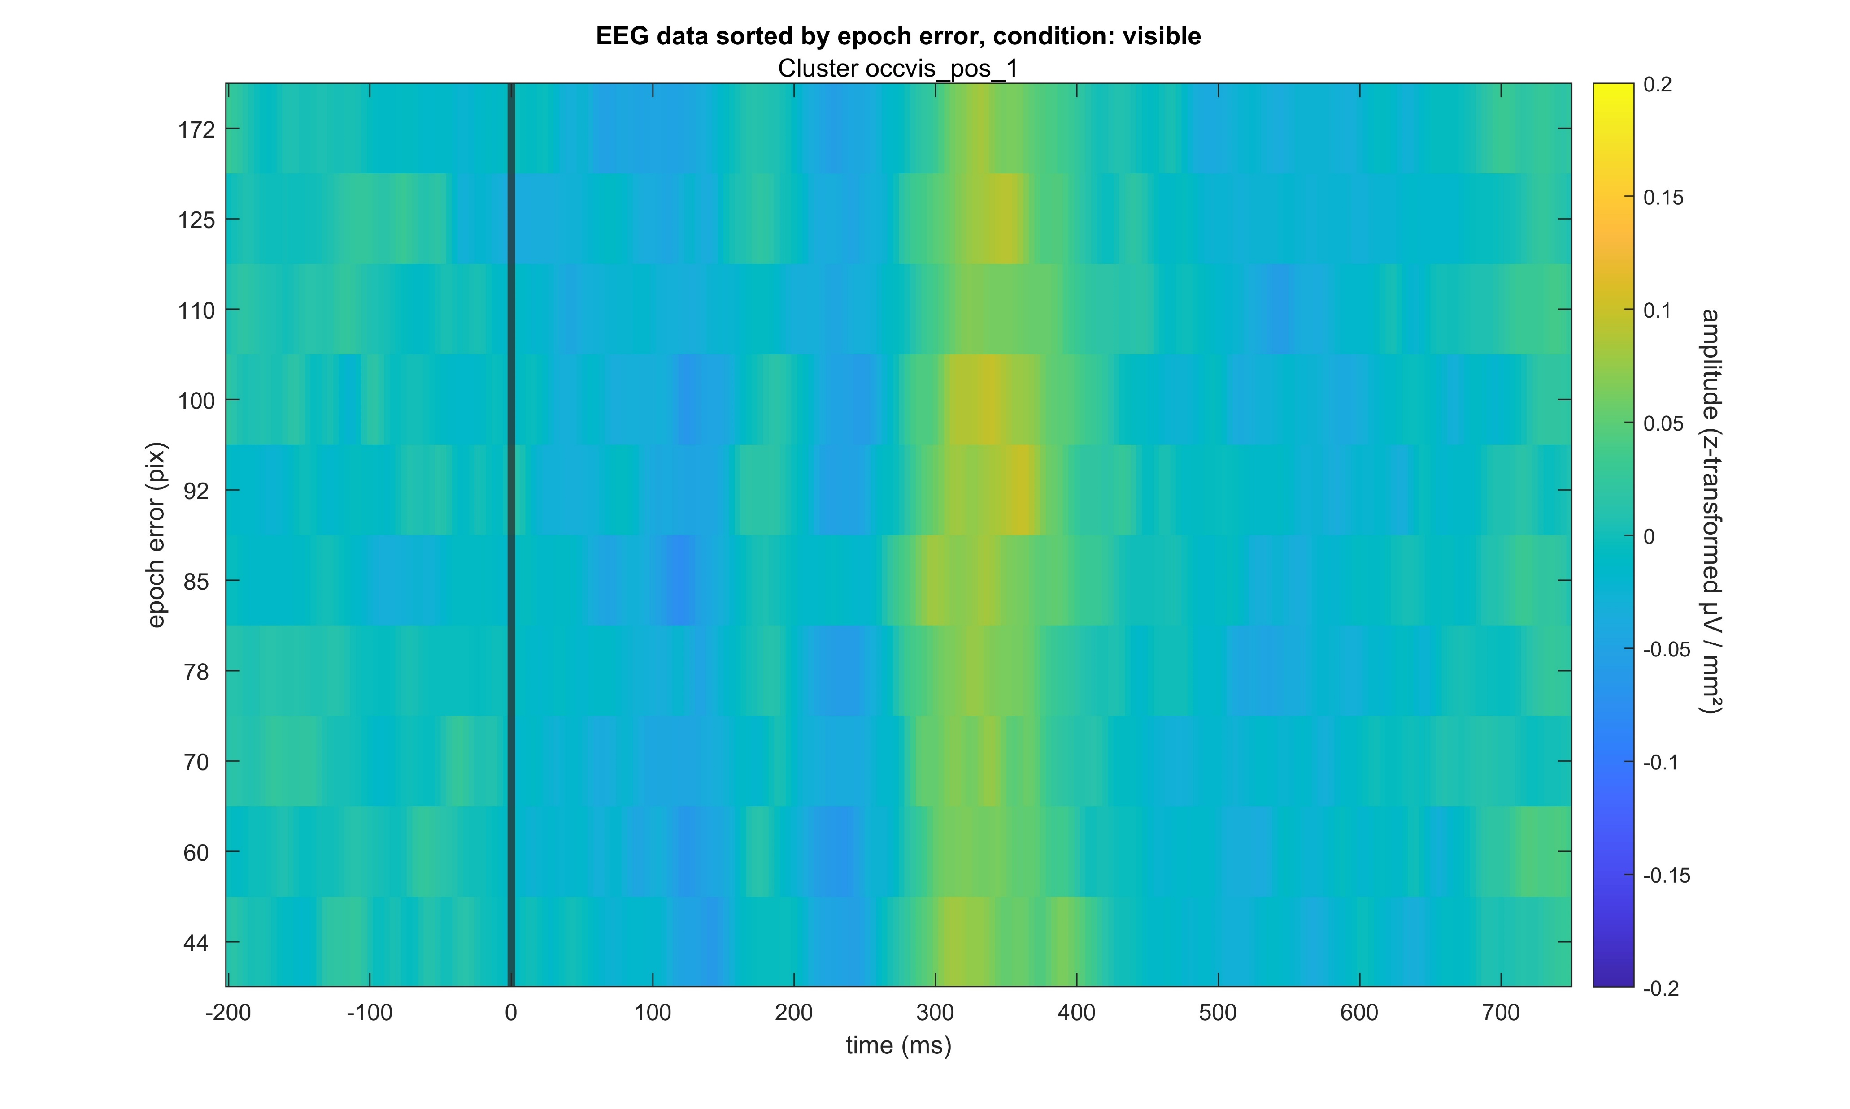
Occluded – Visible positive

Slide 35
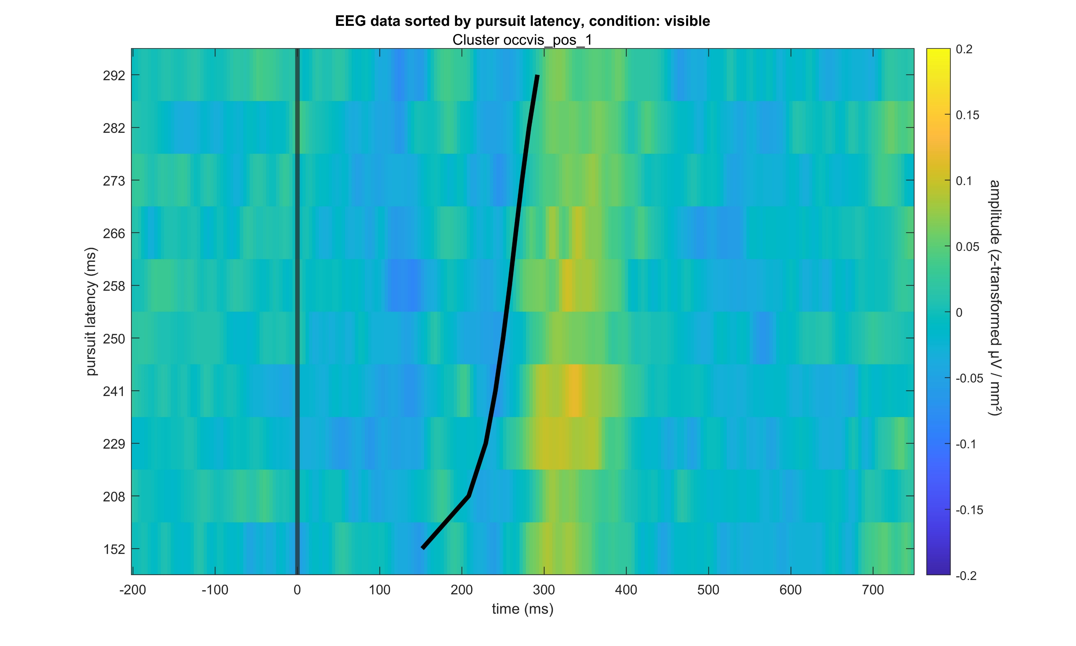
Occluded – Visible positive

Slide 36
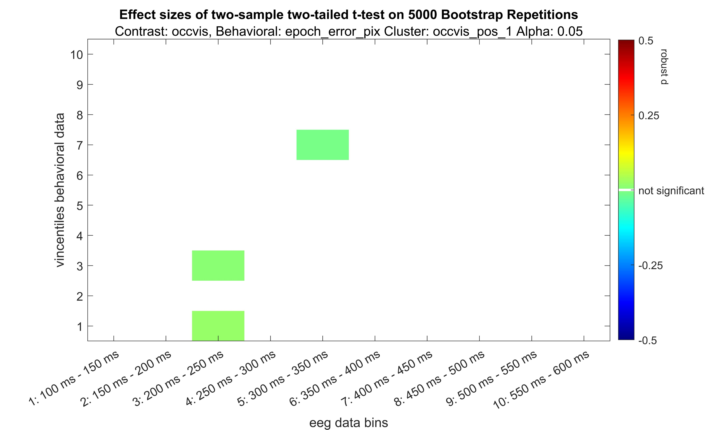
Occluded – Visible positive

Slide 37
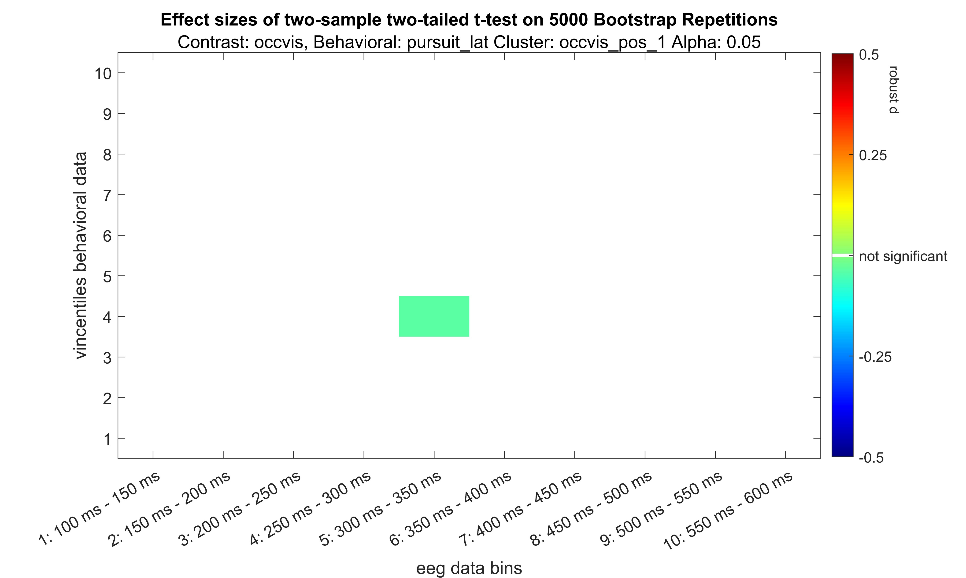
Occluded – Visible positive

Slide 38
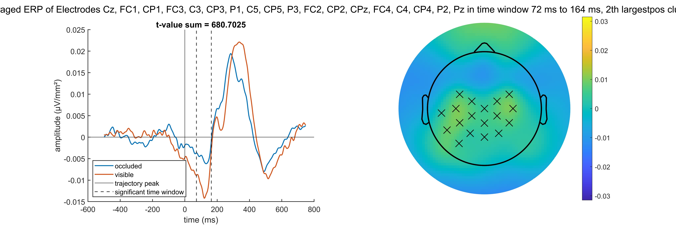
Occluded – Visible positive

Slide 39
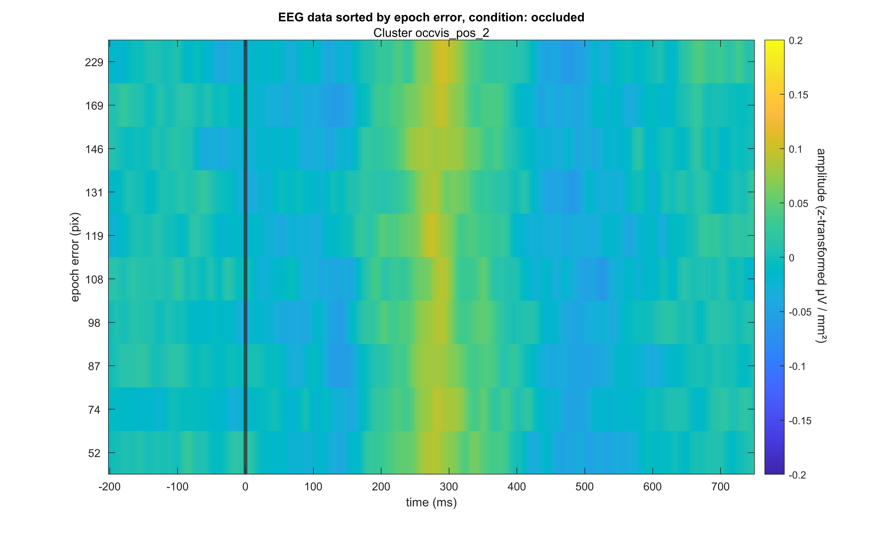
Occluded – Visible positive

Slide 40
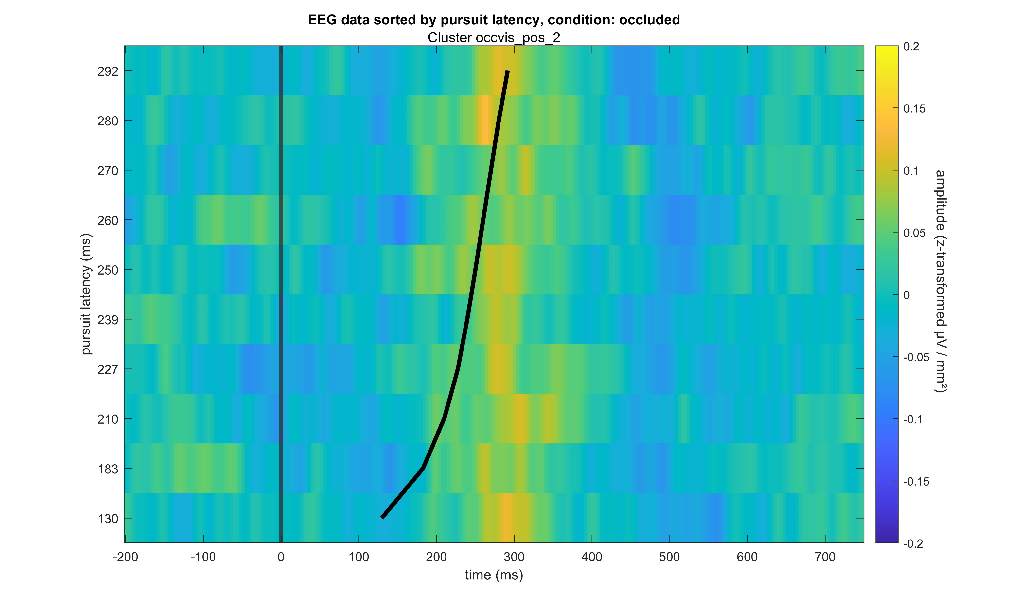
Occluded – Visible positive

Slide 41
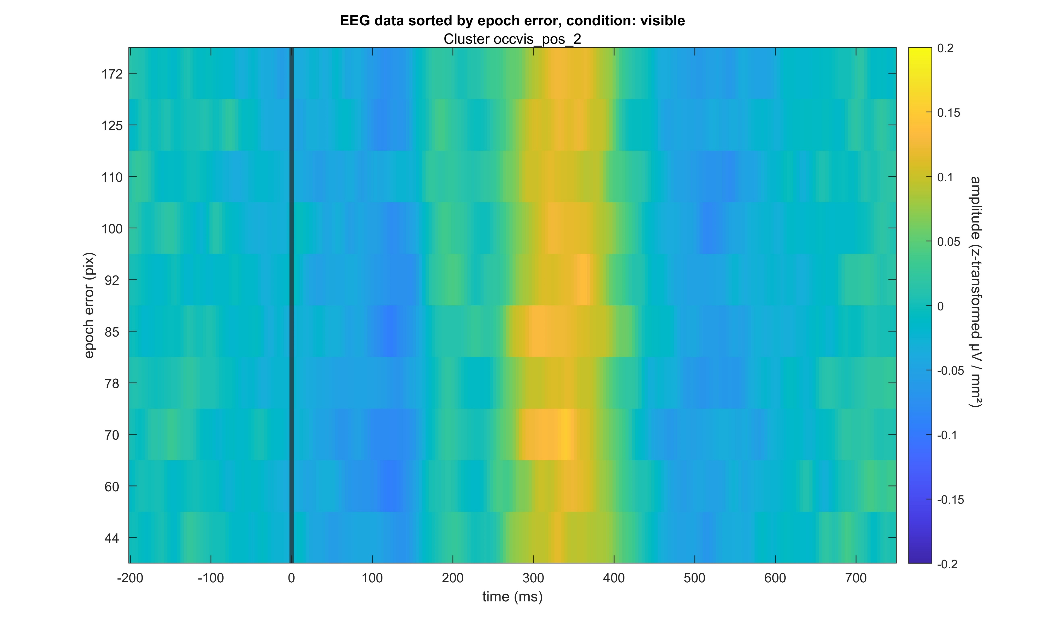
Occluded – Visible positive

Slide 42
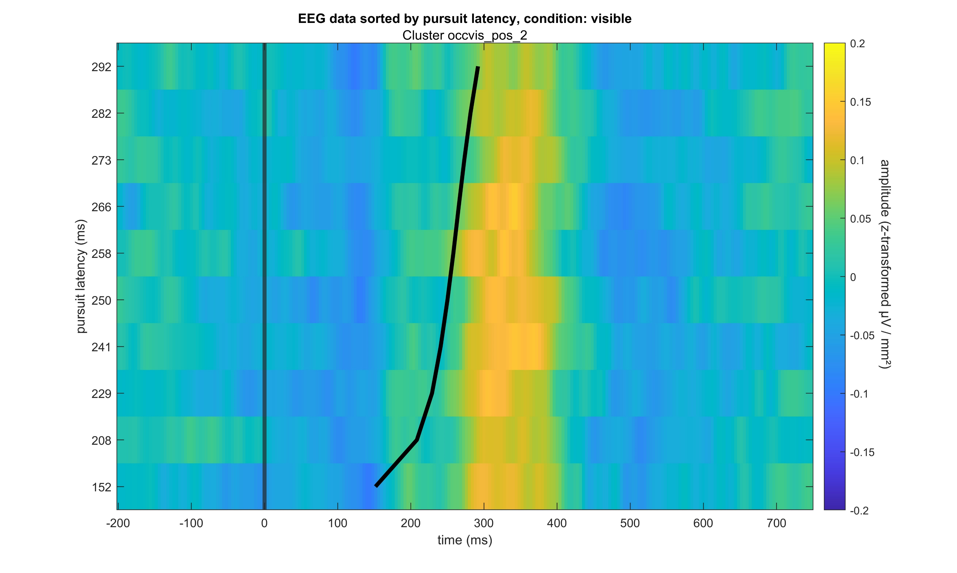
Occluded – Visible positive

Slide 43
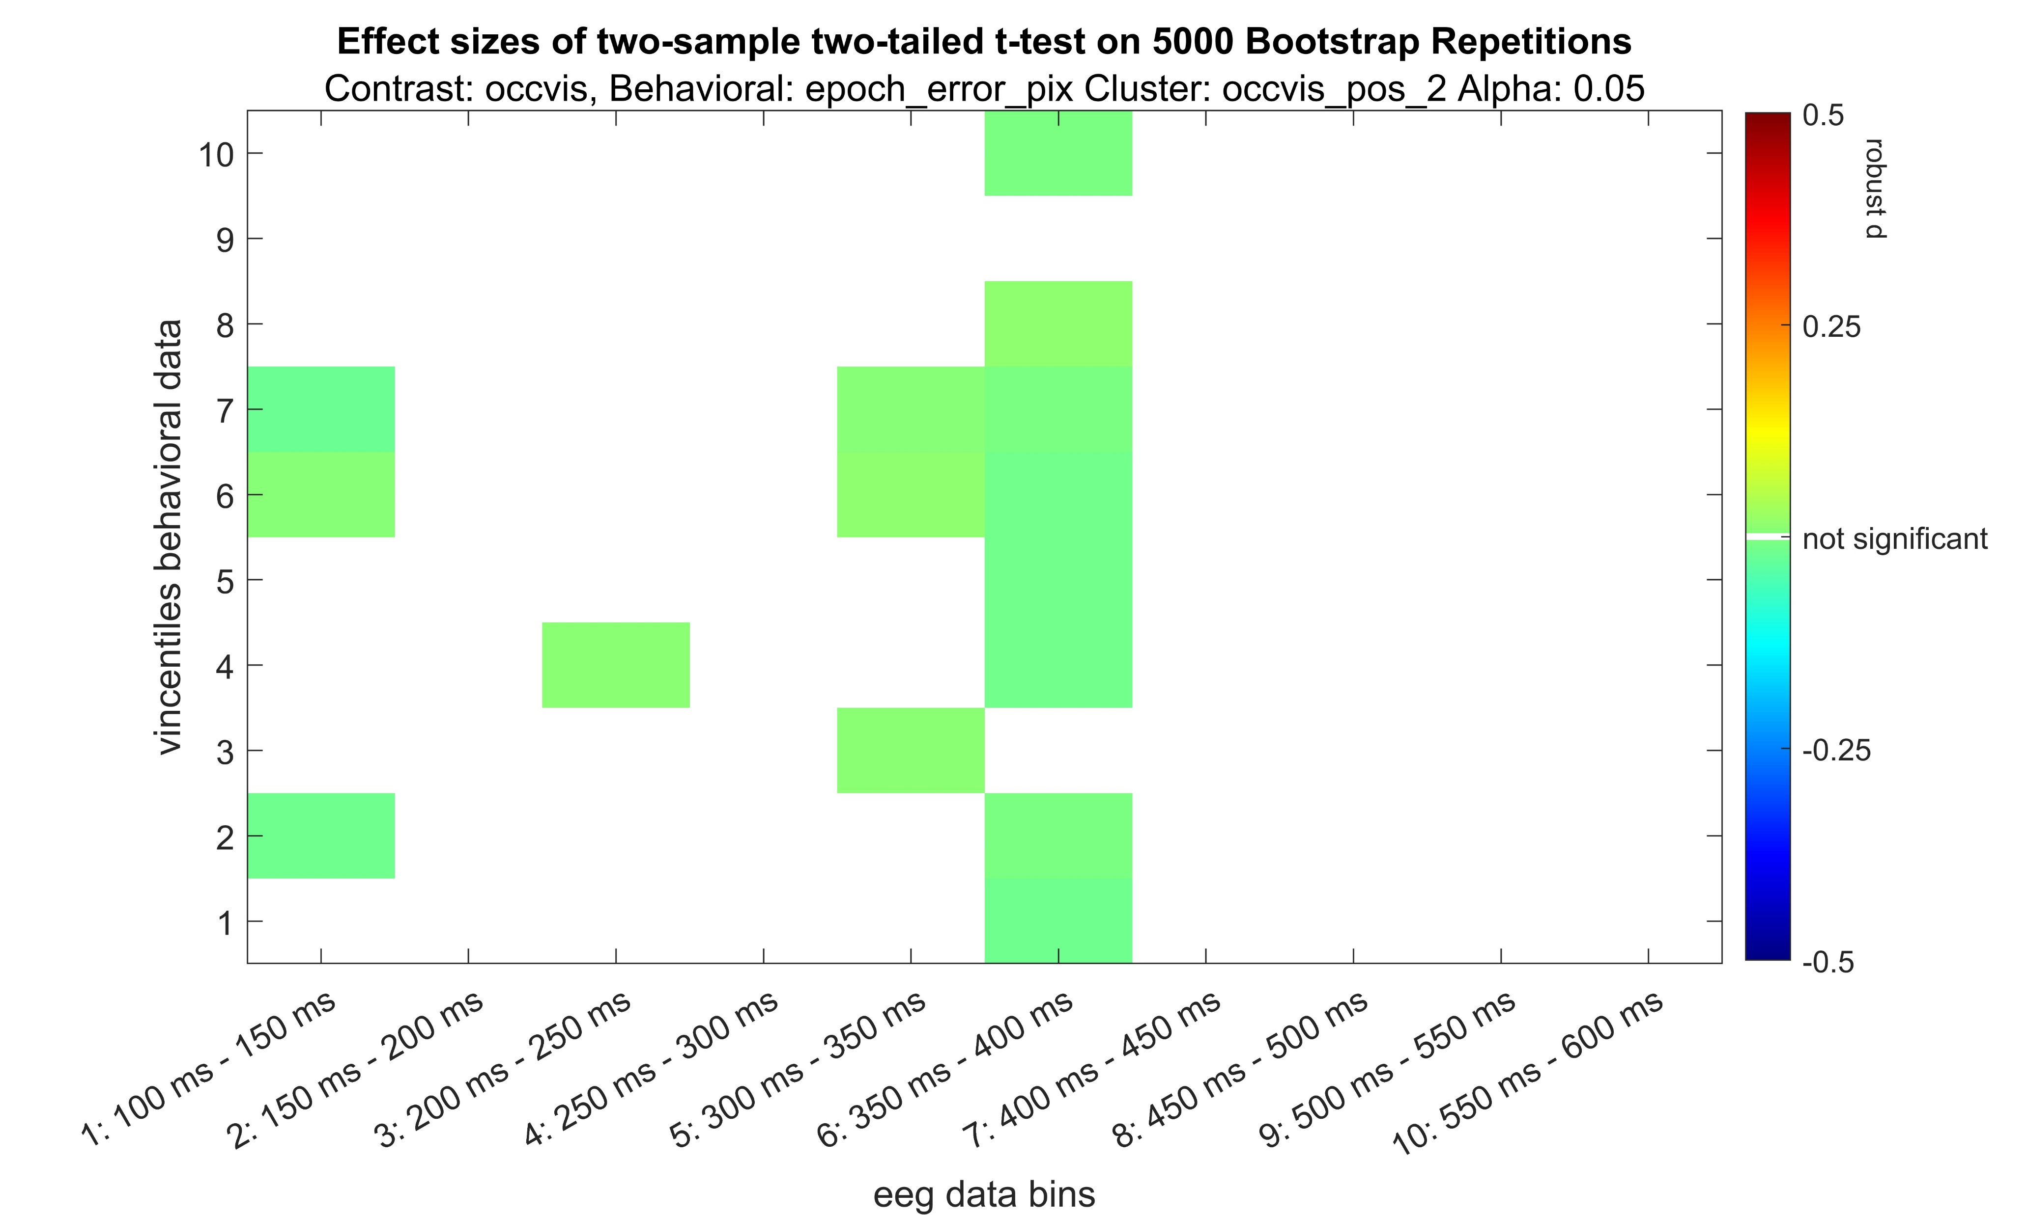
Occluded – Visible positive

Slide 44
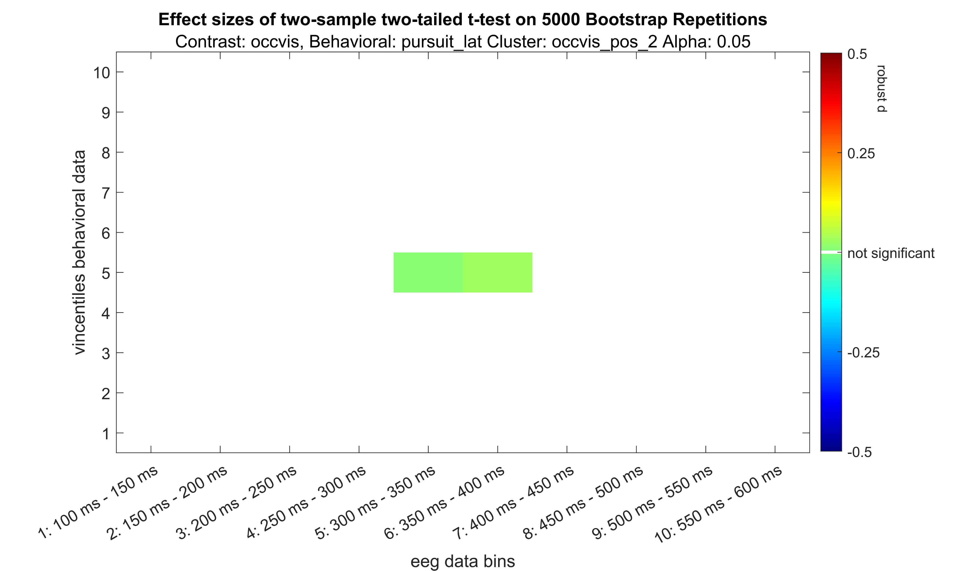
Occluded – Visible positive

Slide 45
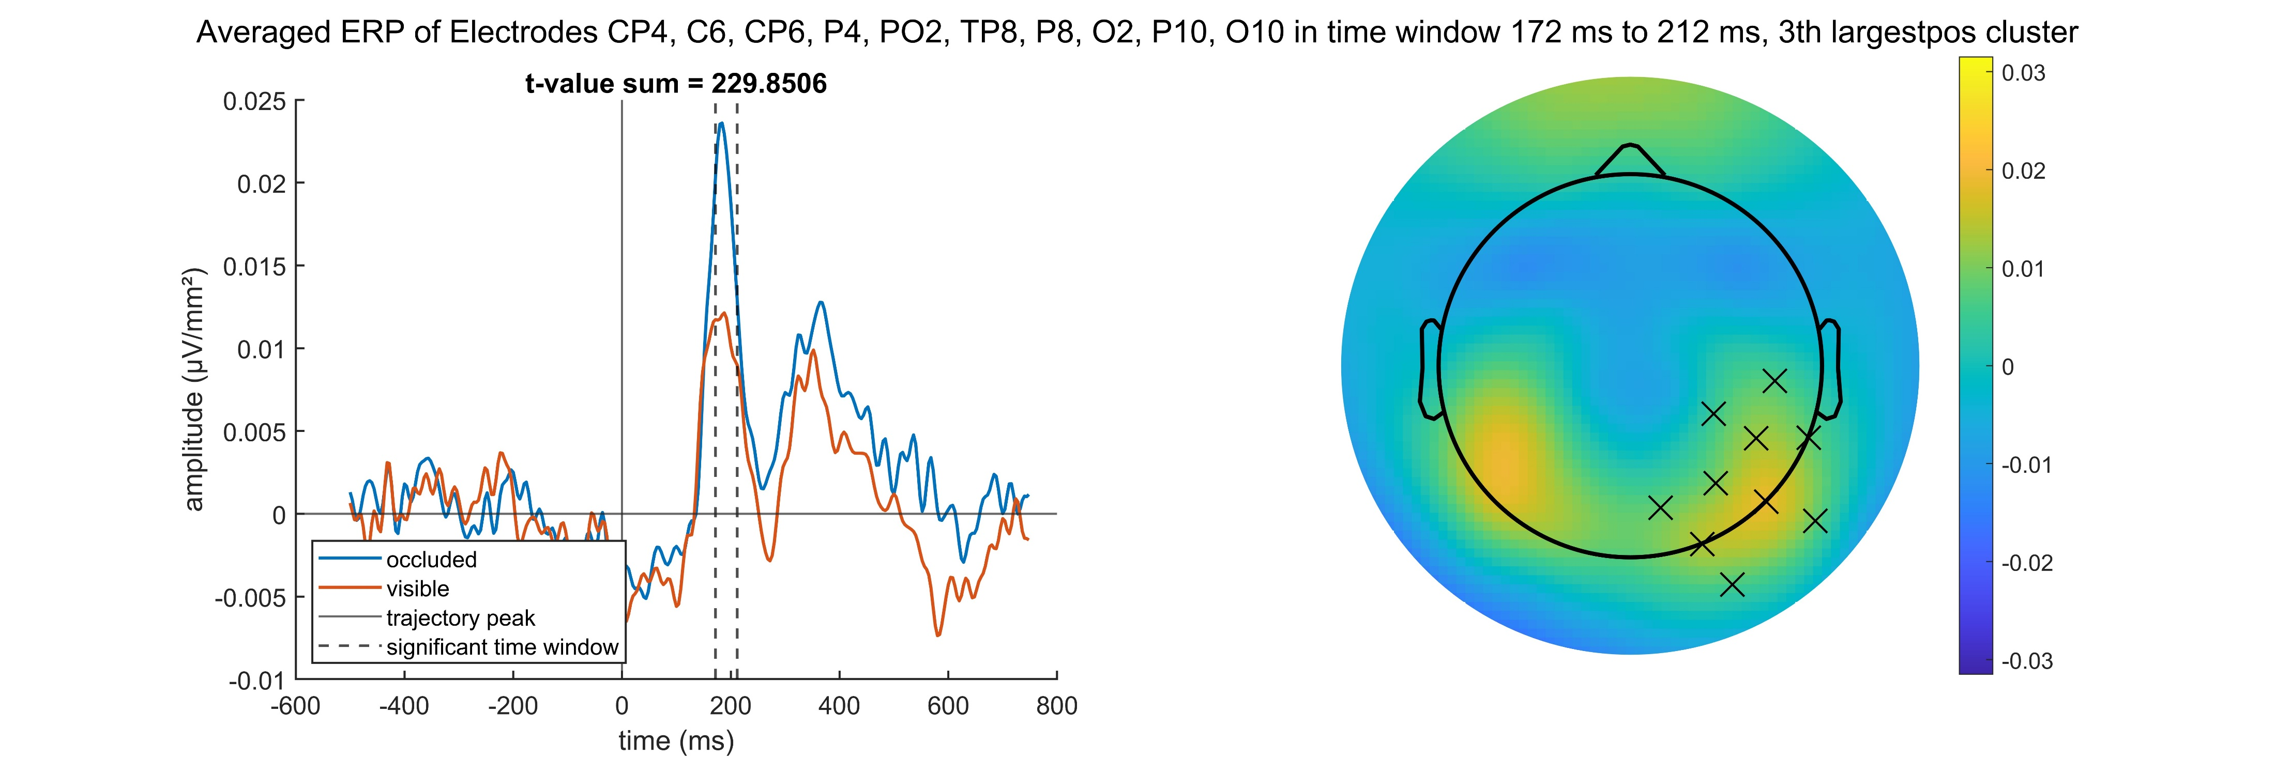
Occluded – Visible positive

Slide 46
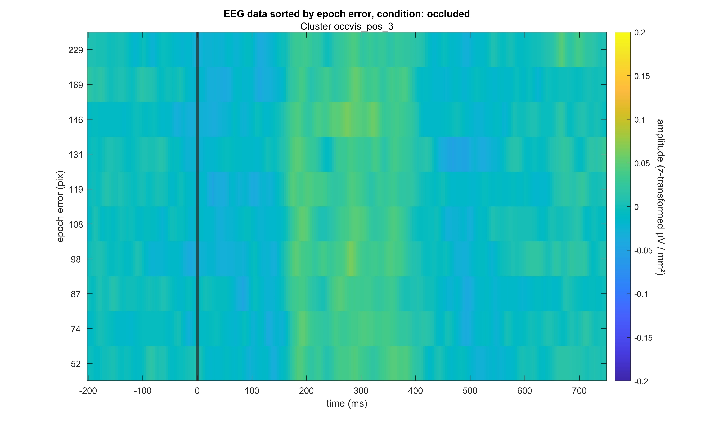
Occluded – Visible positive

Slide 47
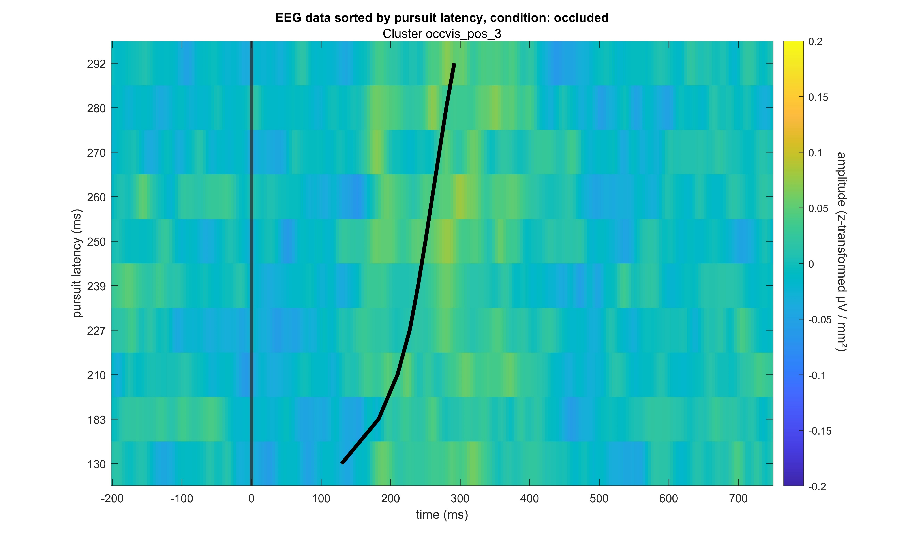
Occluded – Visible positive

Slide 48
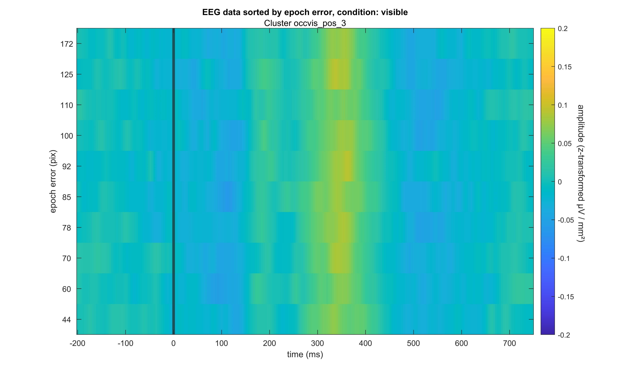
Occluded – Visible positive

Slide 49
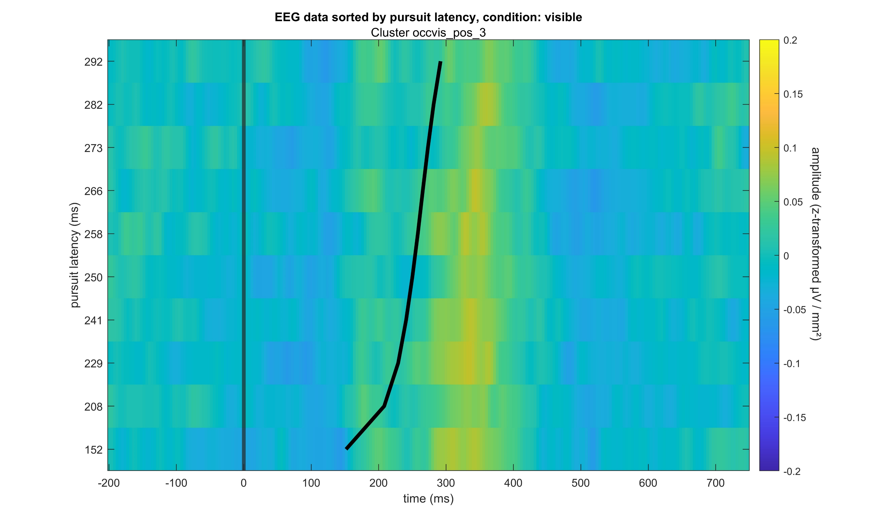
Occluded – Visible positive

Slide 50
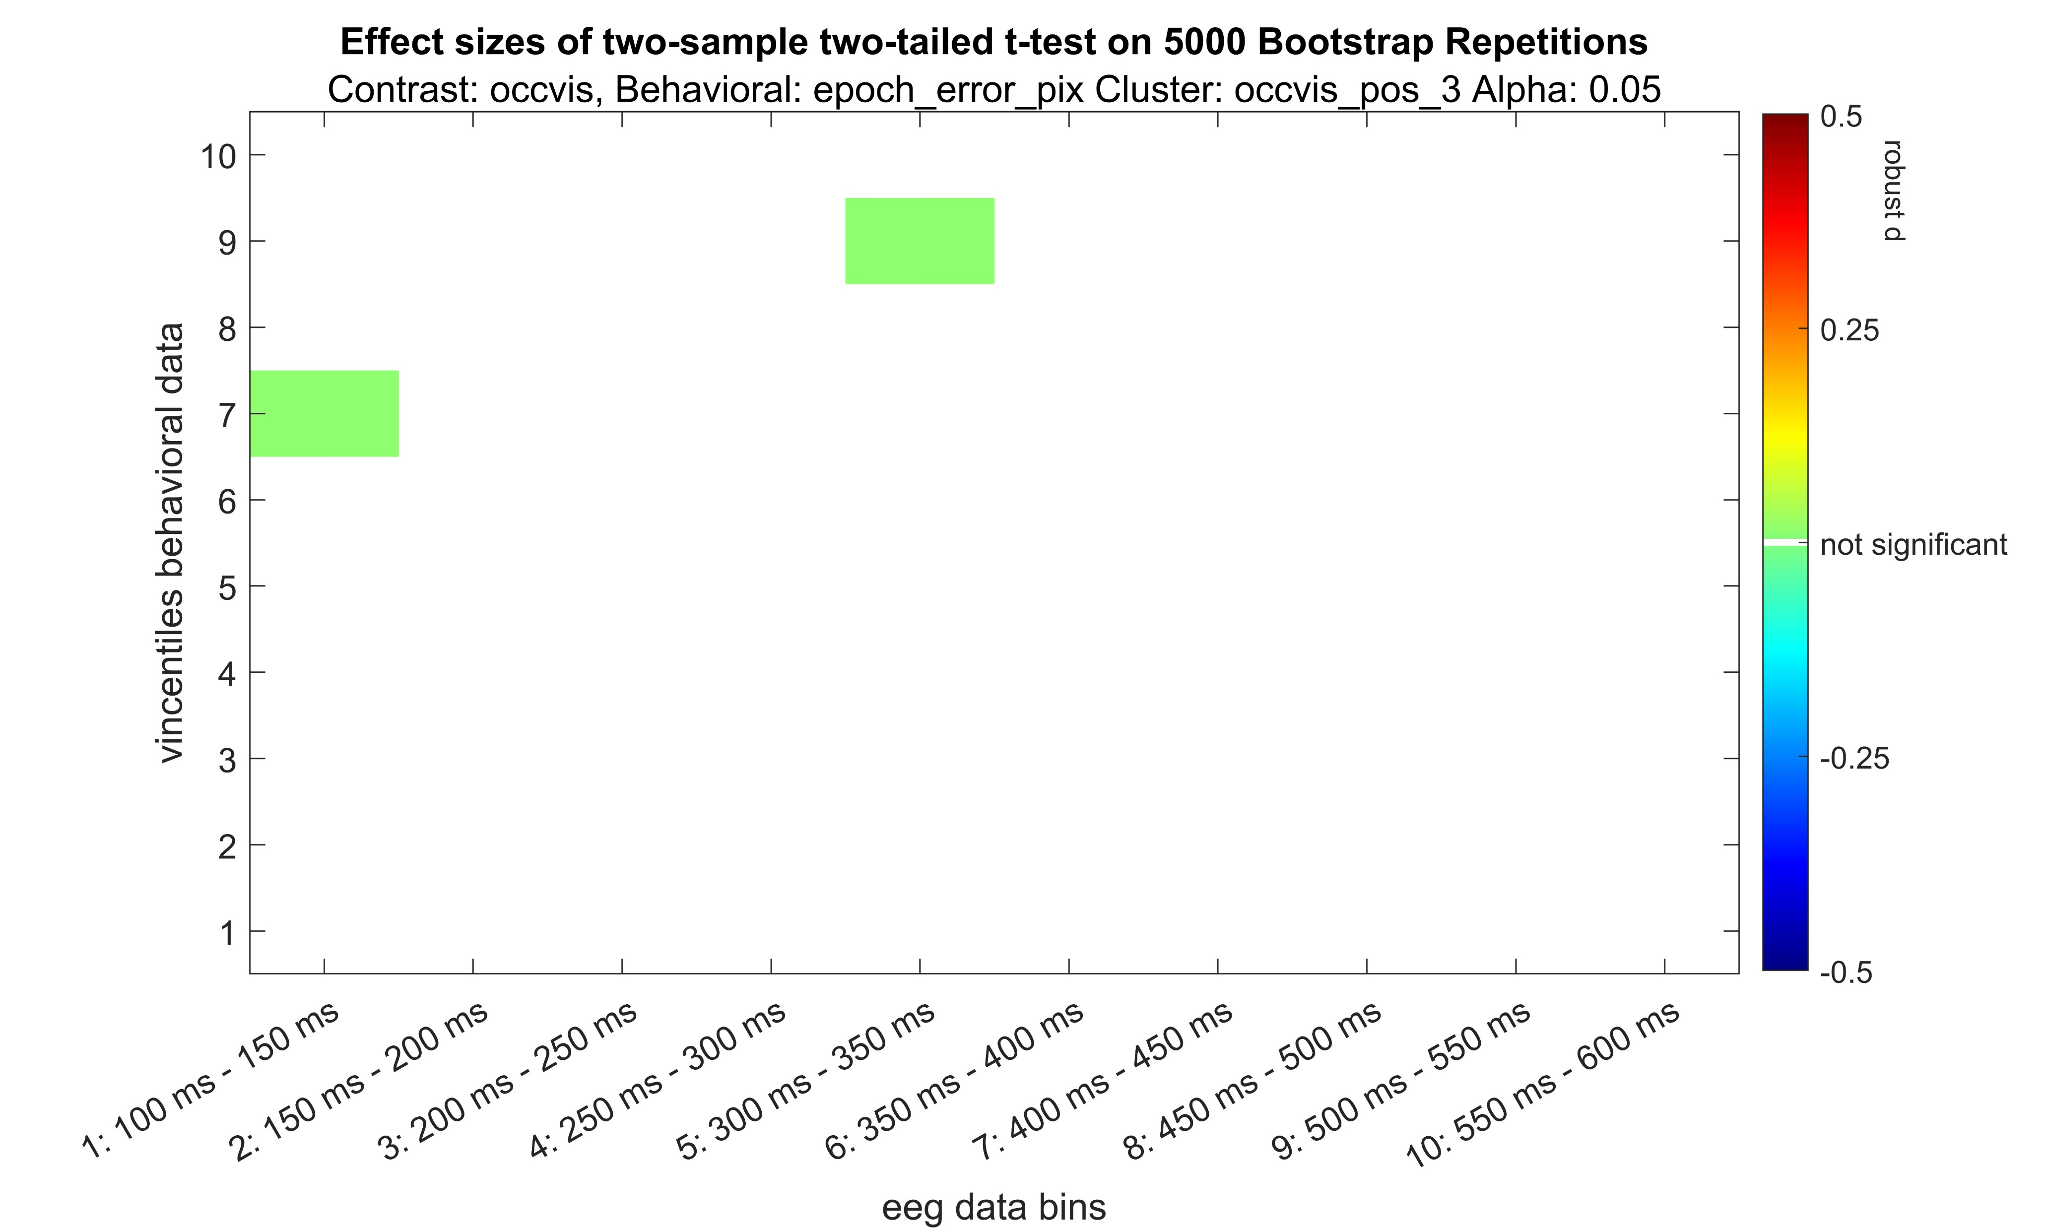
Occluded – Visible positive

Slide 51
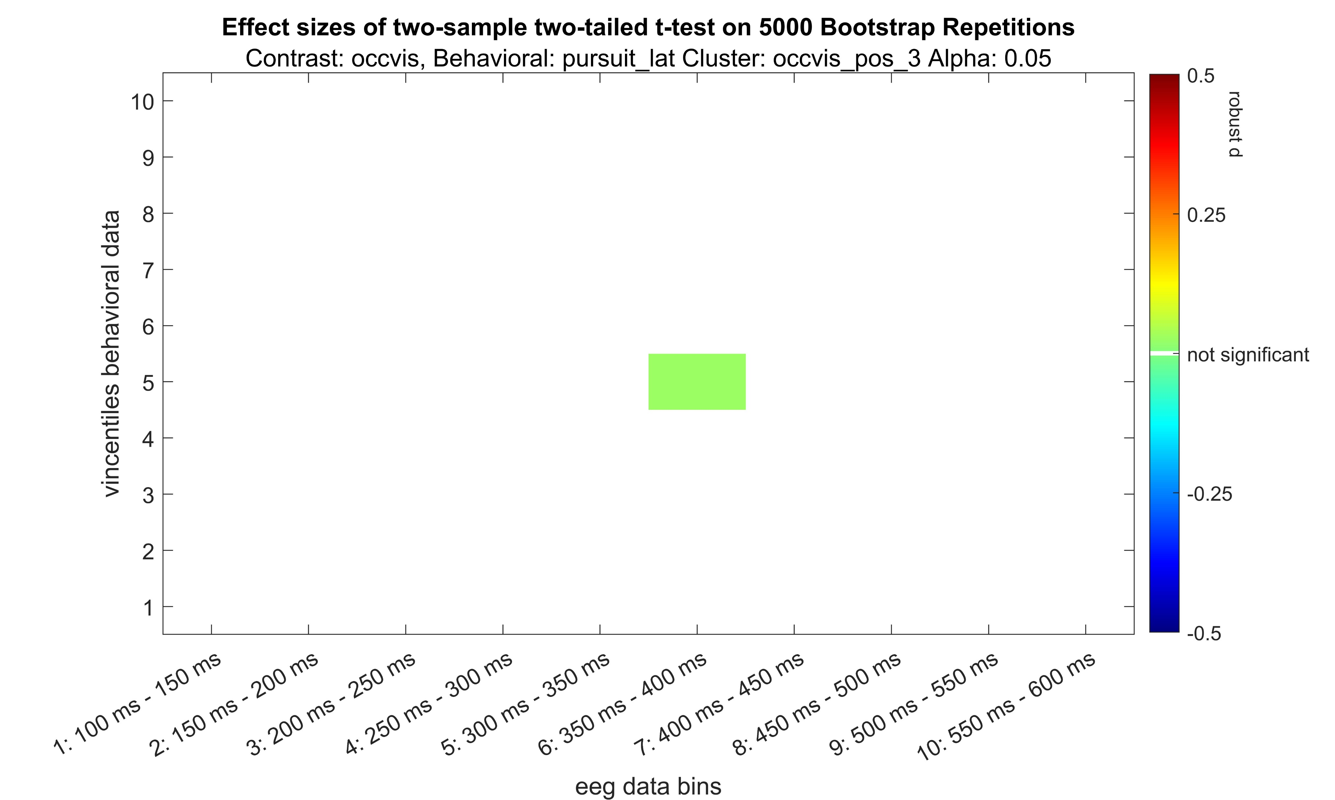
Occluded – Visible positive

Slide 52
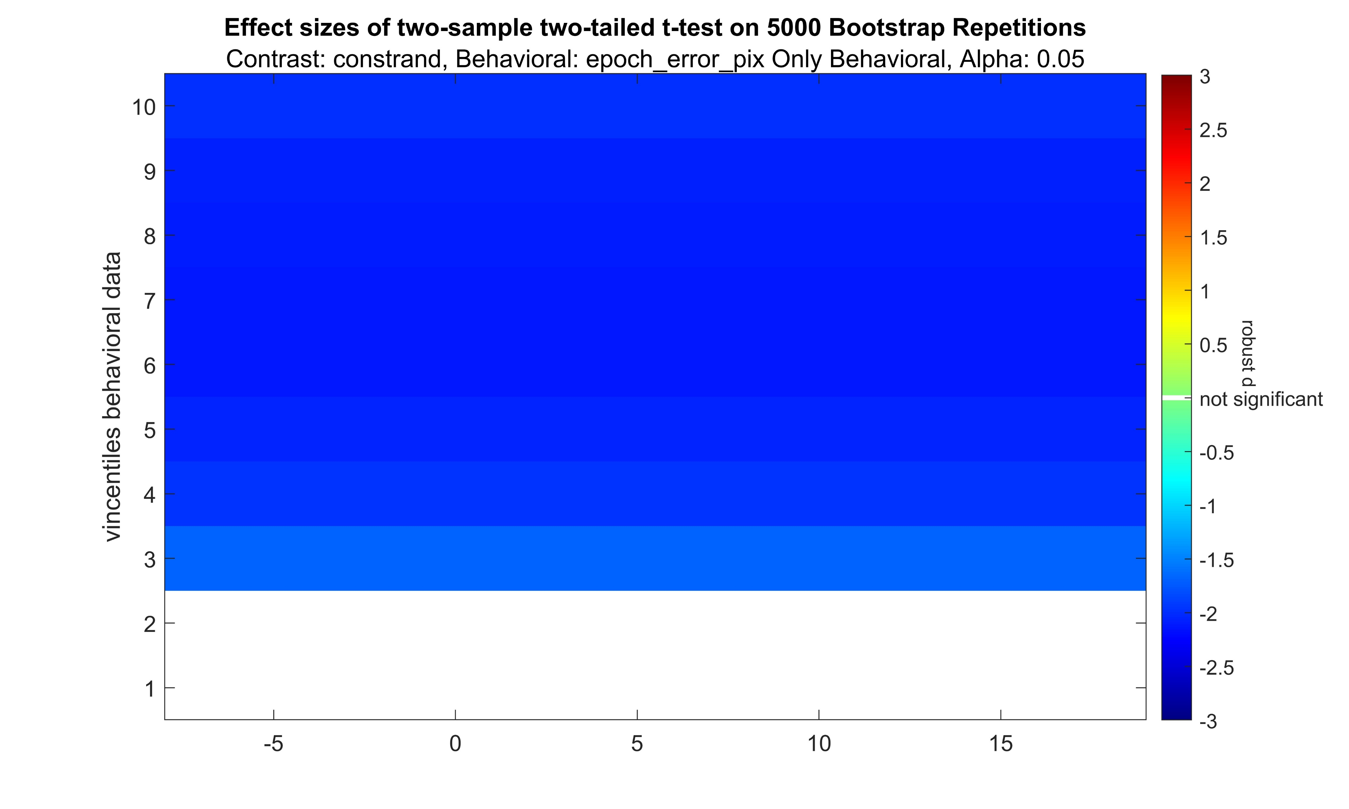
Occluded – Visible positive
Andere Skalierung!

Slide 53
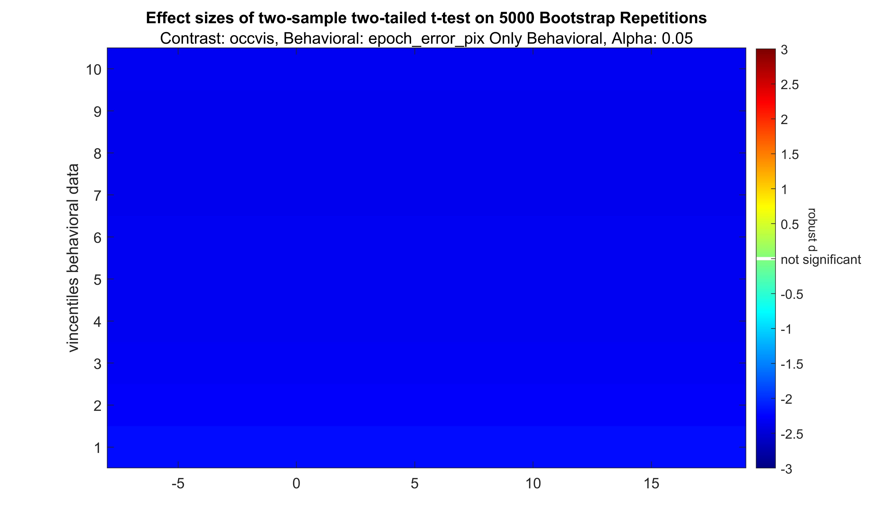
Occluded – Visible positive

Slide 54
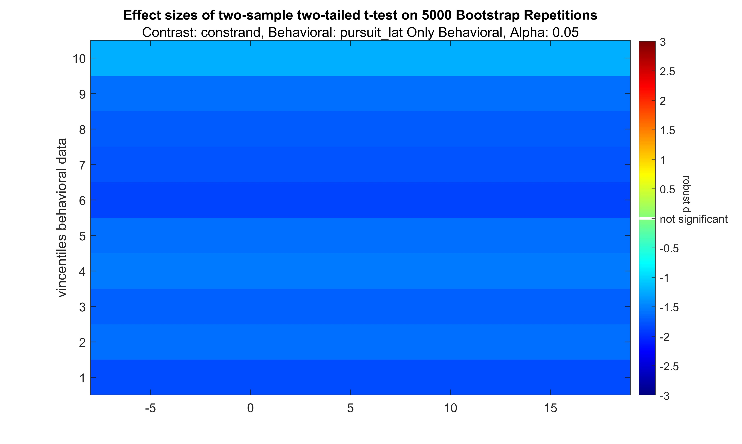
Occluded – Visible positive

Slide 55
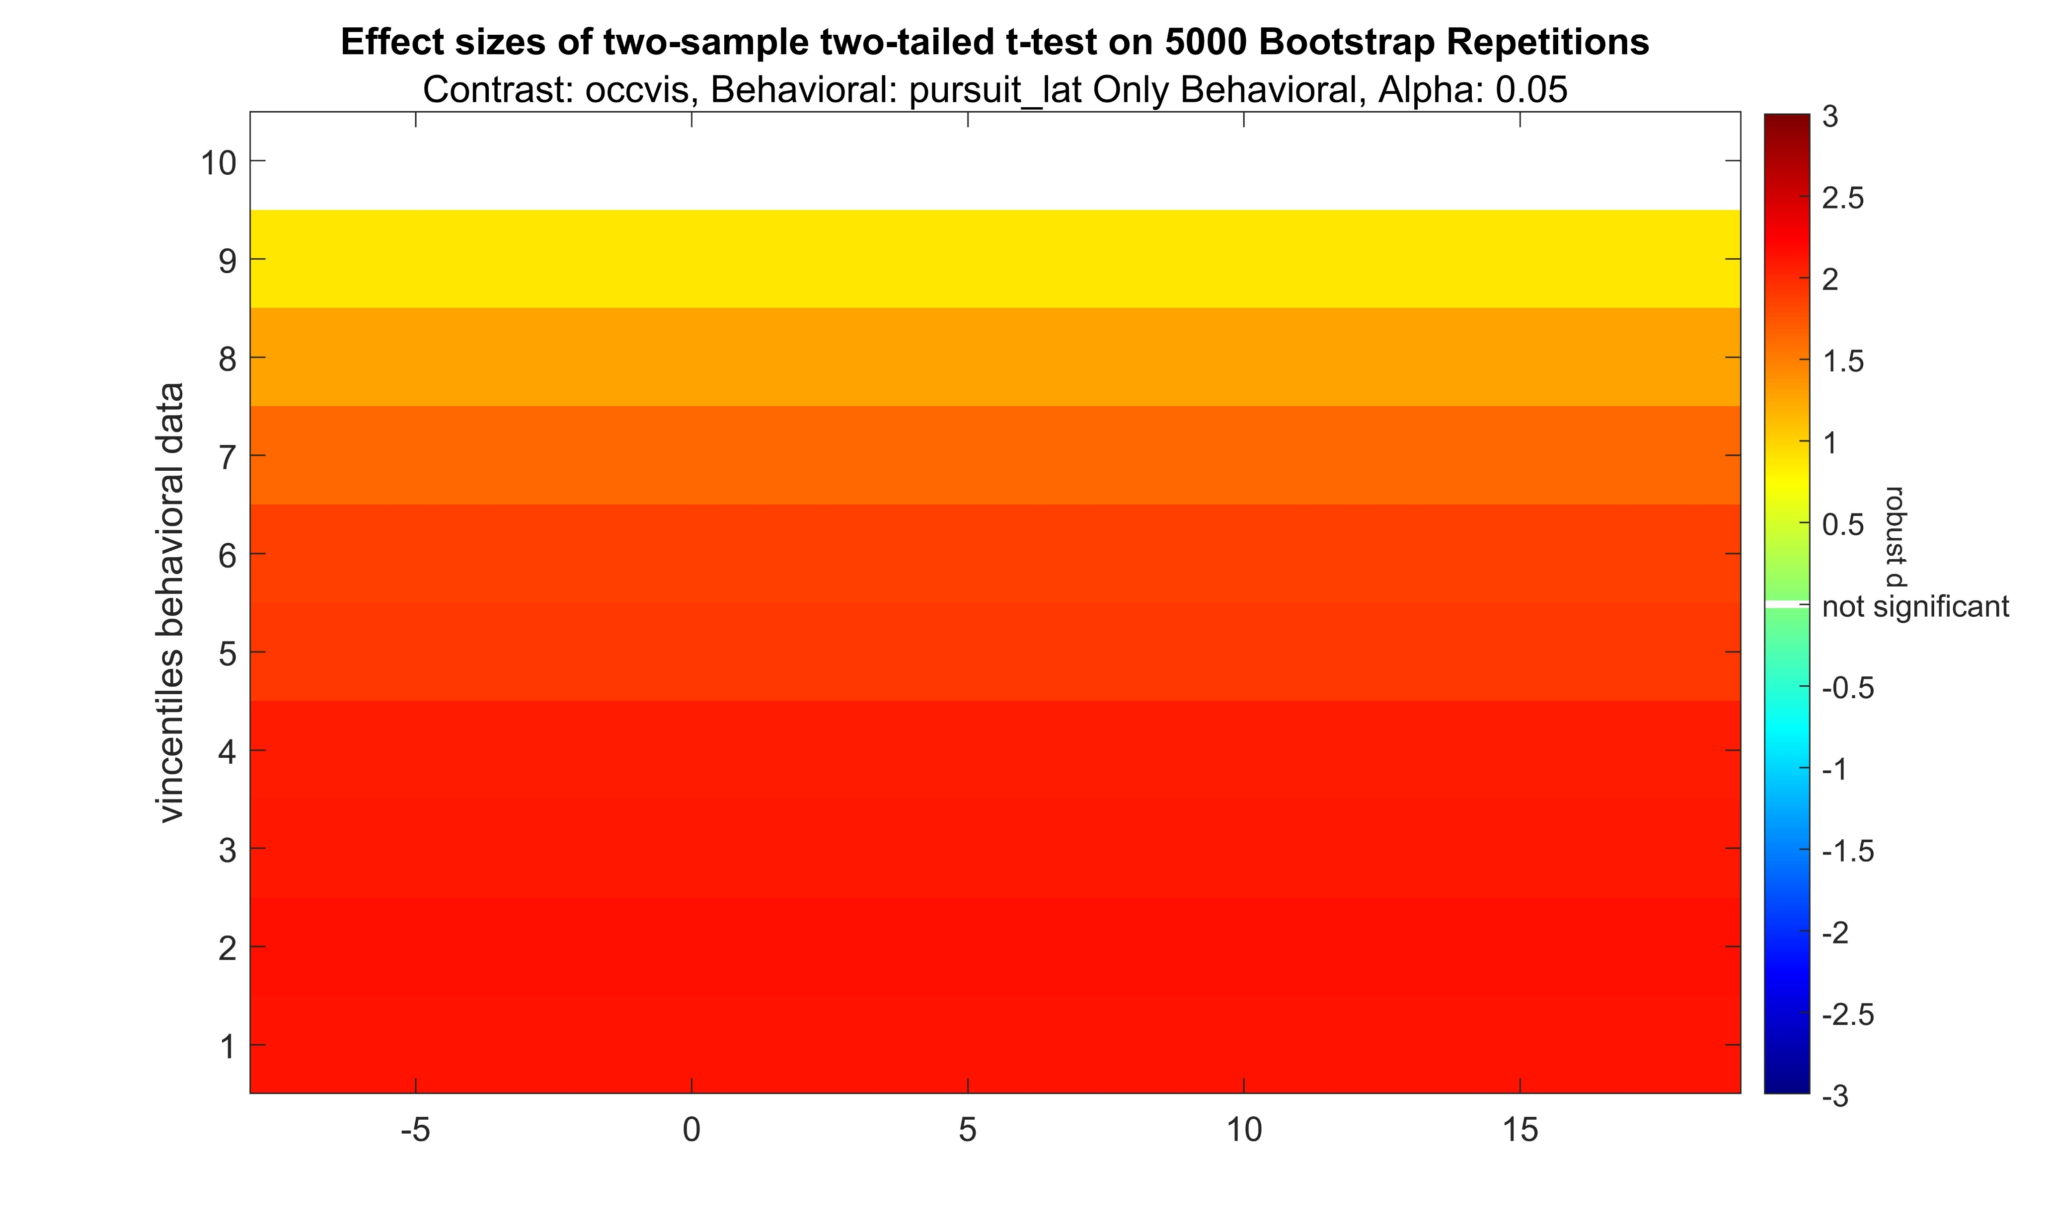
Occluded – Visible positive

